Slide 1
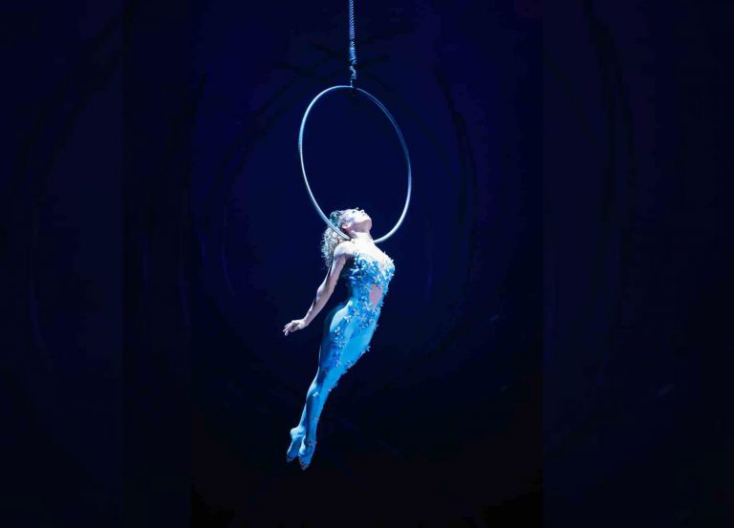
Value Capture in the Face of Known and Unknown Unknowns
Kevin Bryan – Rotman School of Management, University of Toronto
Michael Ryall – Rotman School of Management, University of Toronto
Burkhard C. Schipper – Department of Economics, University of California, Davis

Slide 2
Value Based Strategy
Pioneered by Brandenburger & Stuart (1996): Characteristic function games and the core as tools for studying value creation and value capture (for a survey, Gans and Ryall, 2017)
Confined to complete or symmetric information among firms
How about:
Asymmetric information/different expectations about strategic factors, resources, capabilities, opportunities etc.? (e.g., Barney, 1986)
Asymmetric (Un)awareness: imaginative foresight (Schumpeter, 1911), superior awareness (Knight, 1921), subjective productive opportunities (Penrose, 1959), (entrepreneurial) creativity (Koestler, 1964), alertness to opportunities (Kirzner, 1973), visionary strategies (Schilling, 2018) etc.?

Slide 3
What we (don’t) do in the paper:
Introduce characteristic function games with incomplete information (using ideas from Harsanyi, 1967/68 and Mertens and Zamir, 1985)
Introduce characteristic function games with incomplete information and unawareness (using ideas from Heifetz, Meier, and Schipper, 2006, 2013)
Extend the Coarse Core (Wilson, 1978) to this setting
Explore some examples/cases (Cirque du Soleil, Apple iTunes, …) and extend some basic results on value-capture under complete info to incomplete info and unawareness
Mostly expository: We just scratch the surface of results.
Nothing yet on strategic incentives raise awareness and disclose information, on learning and discovery in dynamic interaction …

Slide 4
Upfront Clarification: unawareness vz. ambiguity/Knightian uncertainty vz. (probabilistic) uncertainty
Incomplete information: Lack of information – Don’t know which state occurred. (Known unknowns)
Form probabilistic assessments
Ambiguity/Knightian uncertainty: lack of confidence in probabilistic judgements
Unawareness: Lack of conception – Cannot even conceive of all events, i.e., state space lacks some events. (Unknown unknowns)
Different from zero probability
Drucker (1985): “Indeed, the greatest praise an innovation can receive is for people to say `This is obvious. Why didn’t I think of it?’”

Slide 5
Illustrative Example: Cirque du Soleil
Fresh take on traditional circus: big-top tent, no live animal acts, street performers, dramatic narrative, original soundtrack
20-fold increase of revenue from 1995 to 2007
Apparently nobody thought previously about this “Schumpeterian” recombination
Featured in Mauborgne and Kim’s book on “Blue ocean strategy”

Slide 6
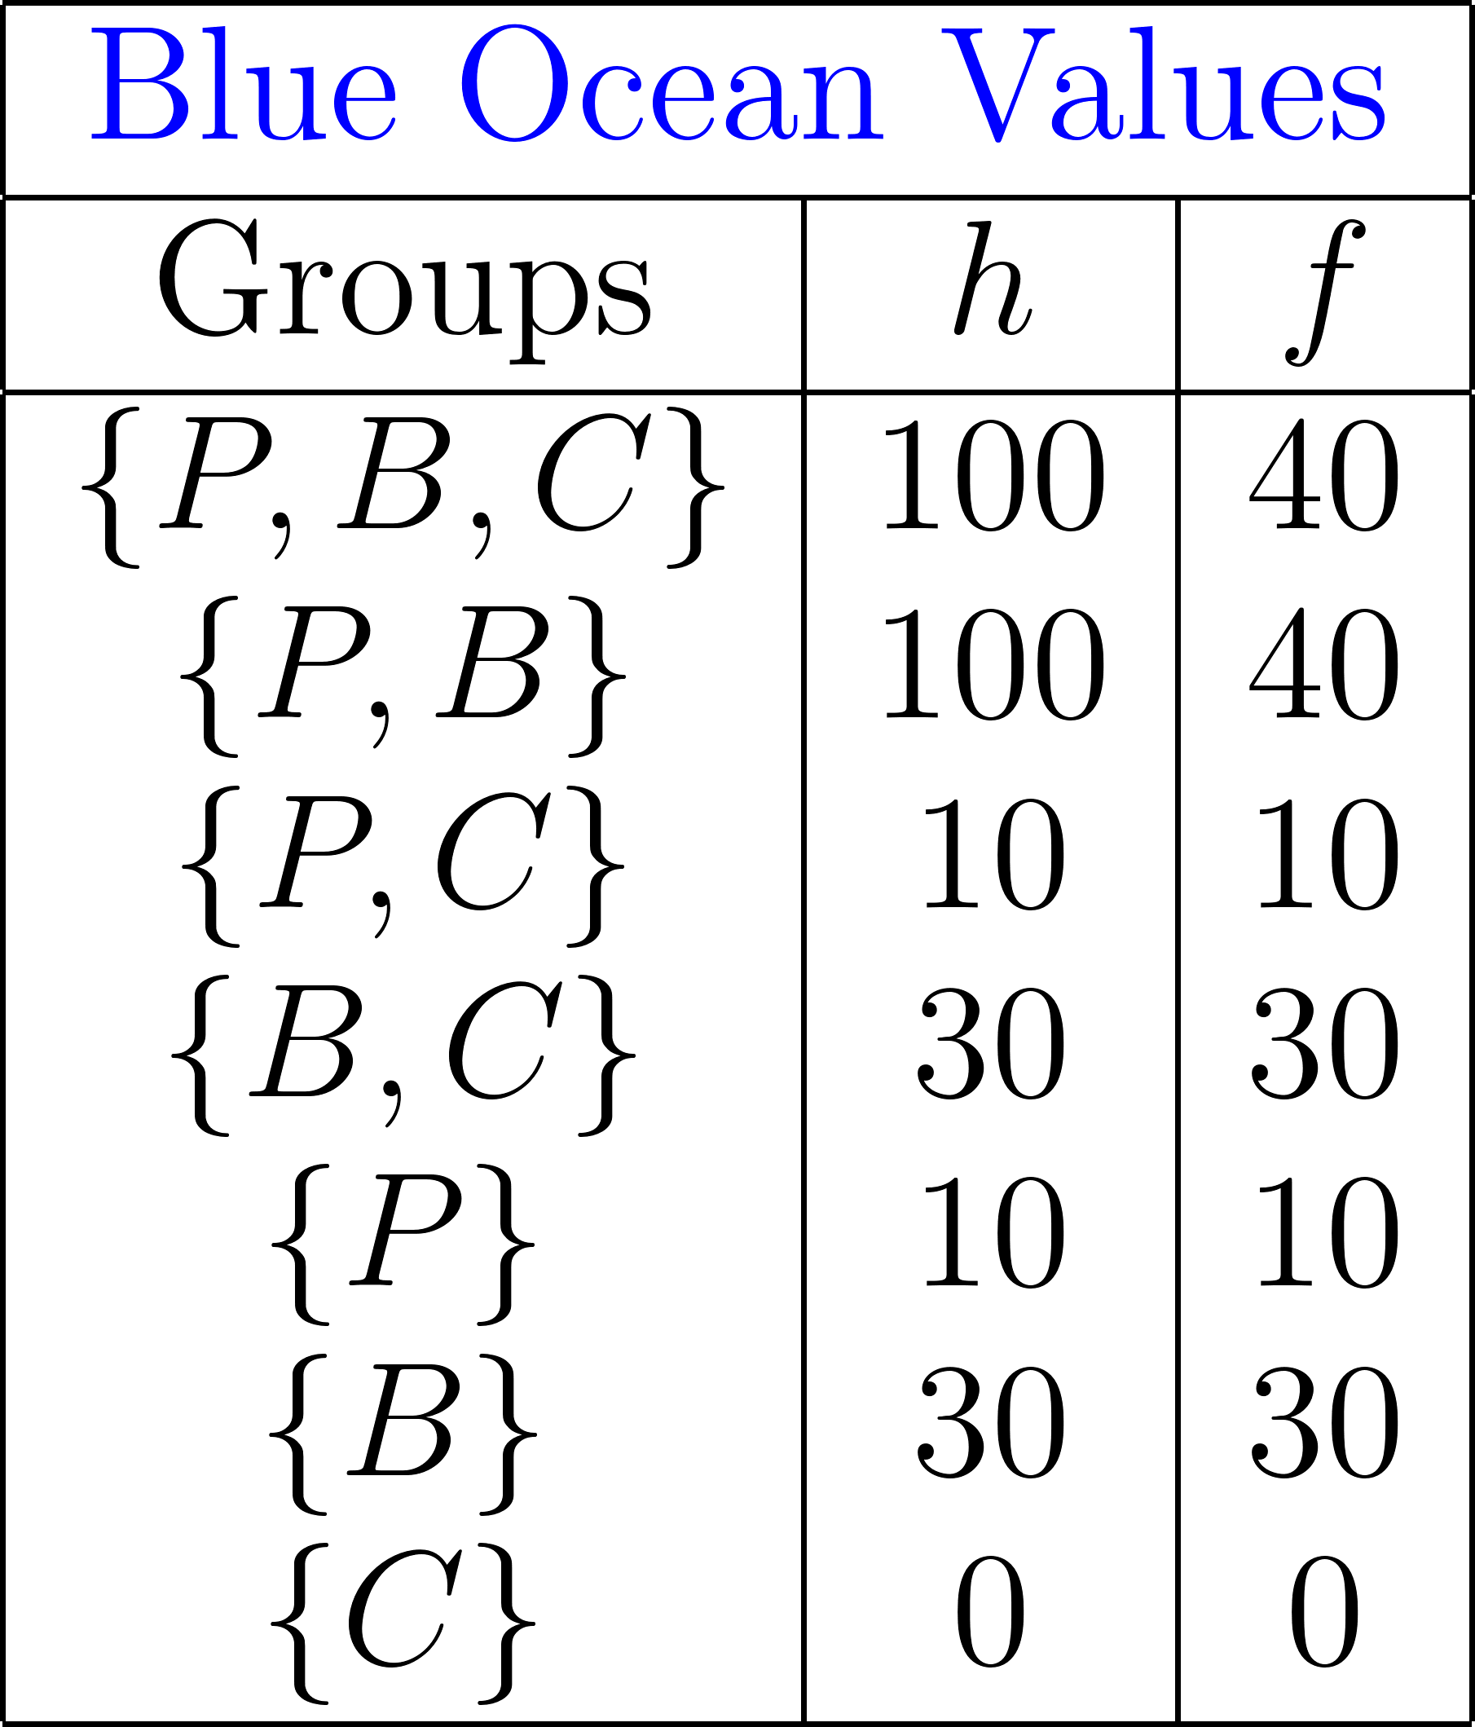
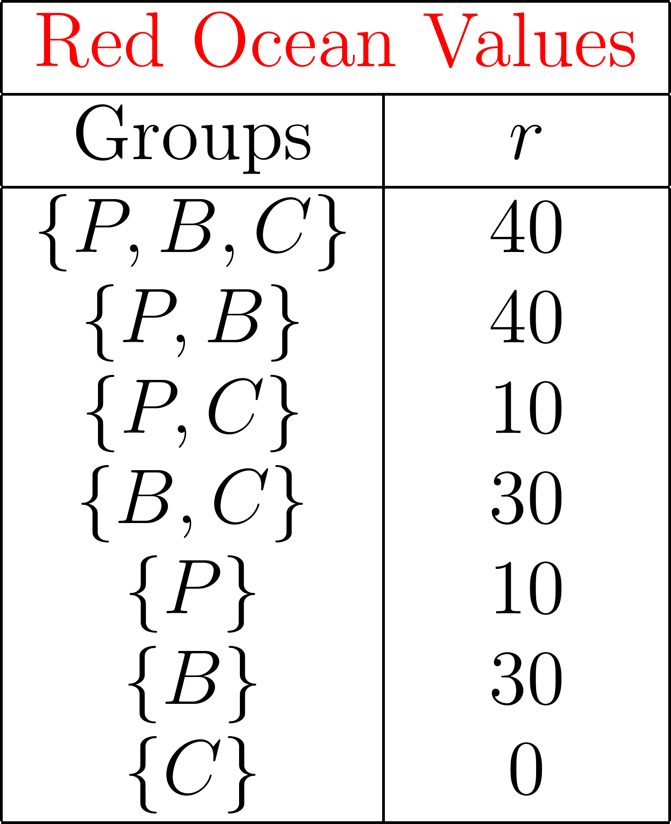
“Blue Ocean Space”
½ ½
h
f
Note: At every state,
C’s added value is zero.
“Red Ocean
Space”
r
Big Top Circus (B) & Street Performer (P)
Cirque du Soleil (C)

Slide 7
What about value-capture? Idea of the Core:
Under complete info:
Incompl. info & unawareness:
Feasibility
Cannot allocate more value than it is created.
Impose feasibility state-by-state
Competitive consistency
No group of firms agrees to deviate pursing feasible alternative deals.
No group of firms commonly believes that they have a better feasible alternative deal.
Coarse Core by Wilson (1978)

Slide 8
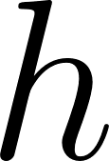
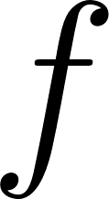
B’s
P’s
C’s
payoffs

Slide 9
Although, C’s added value is zero at every state, C contributes imaginative foresight.
C captures an awareness rent
•
B’s
P’s
C’s
Here the coarse core can be implemented with bilateral employment contracts as it happened in reality.
payoffs
•

Slide 10
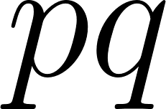
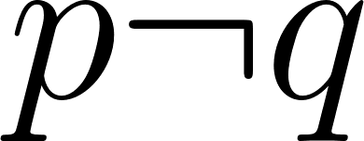
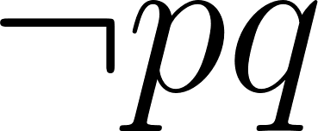
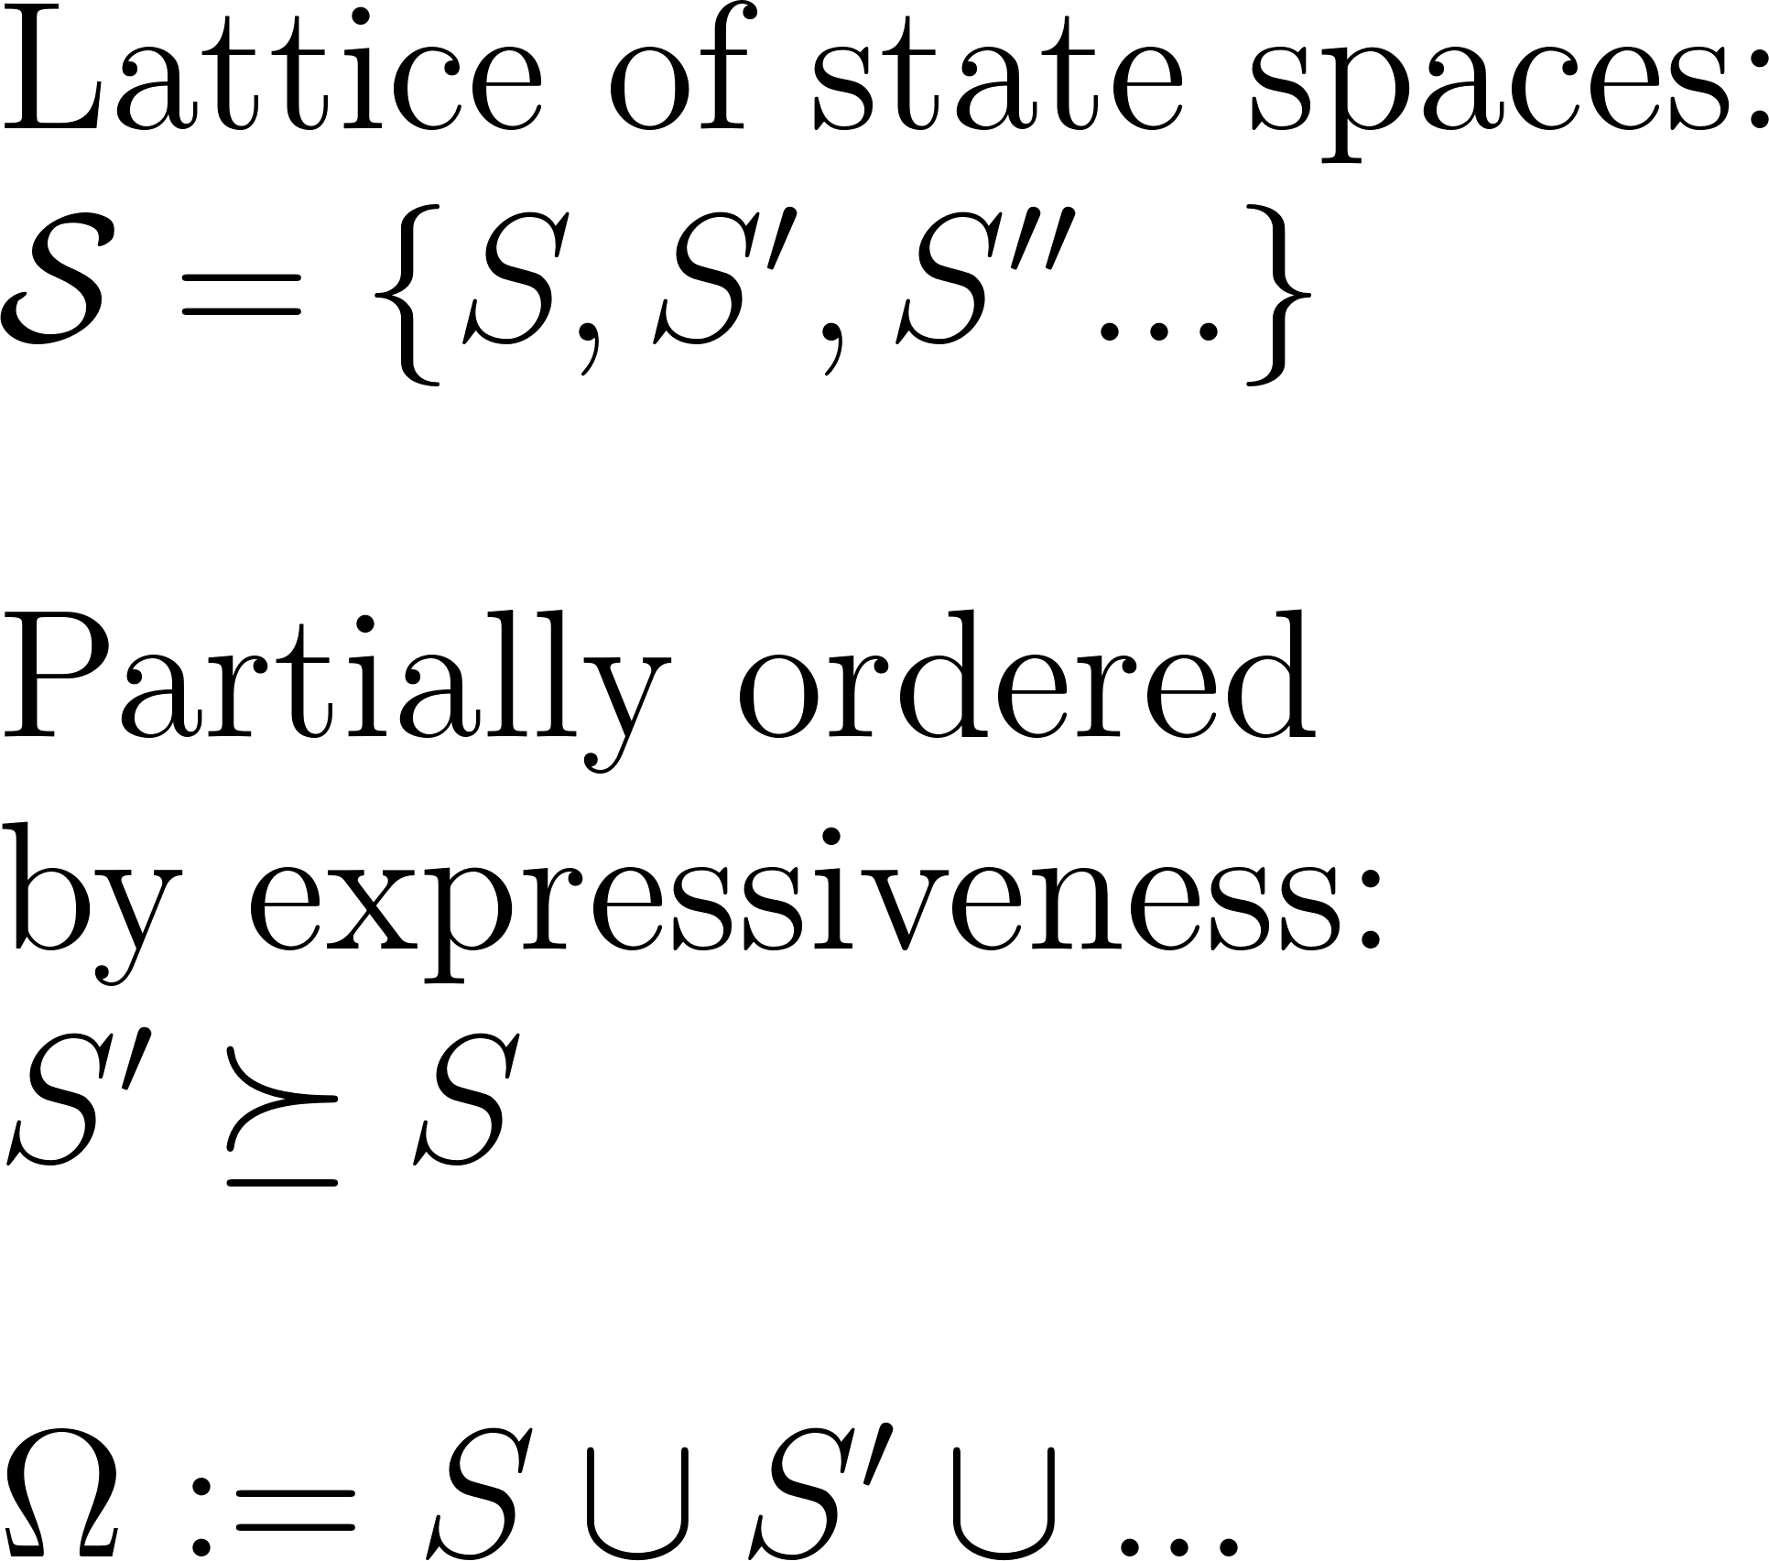
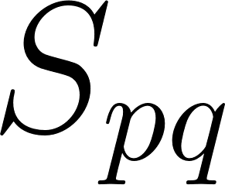
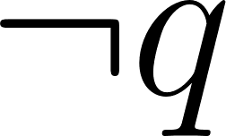
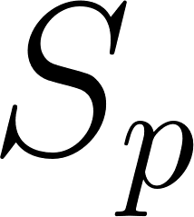
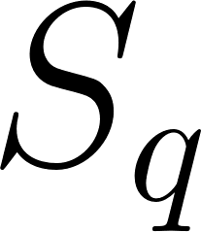
General Model:
●
●
●
●
●
●
●
●
●

Slide 11
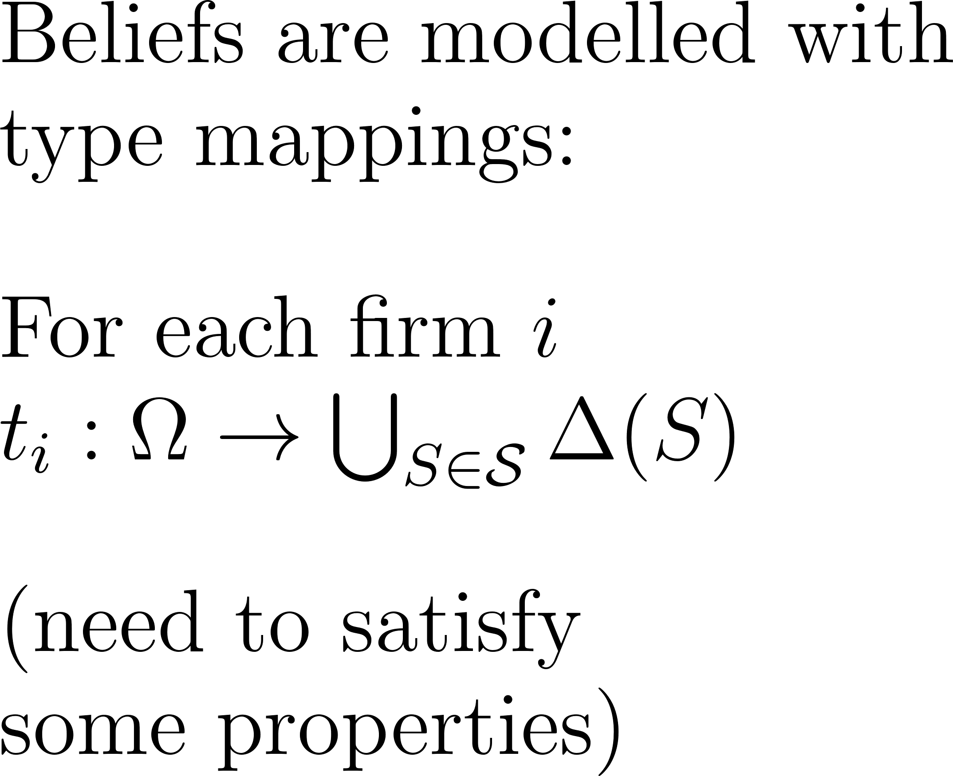
●
●
●
●
●
●
●
●
●

Slide 12
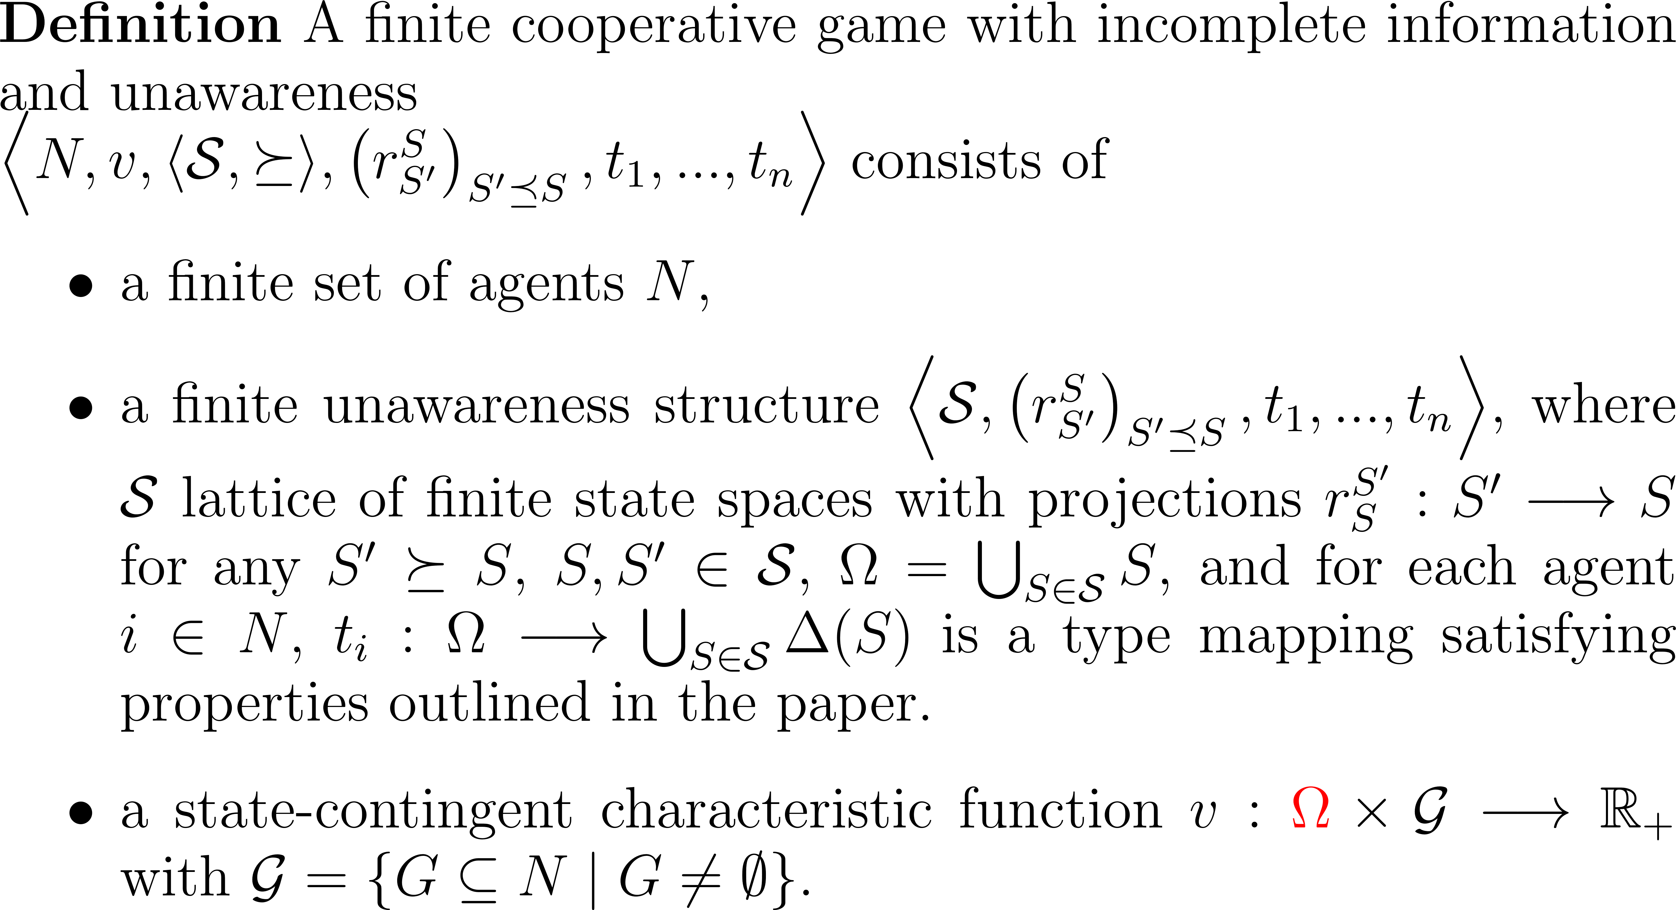
Value Creation Game:

Slide 13
Value Capture:

Slide 14
Value Capture:

Slide 15
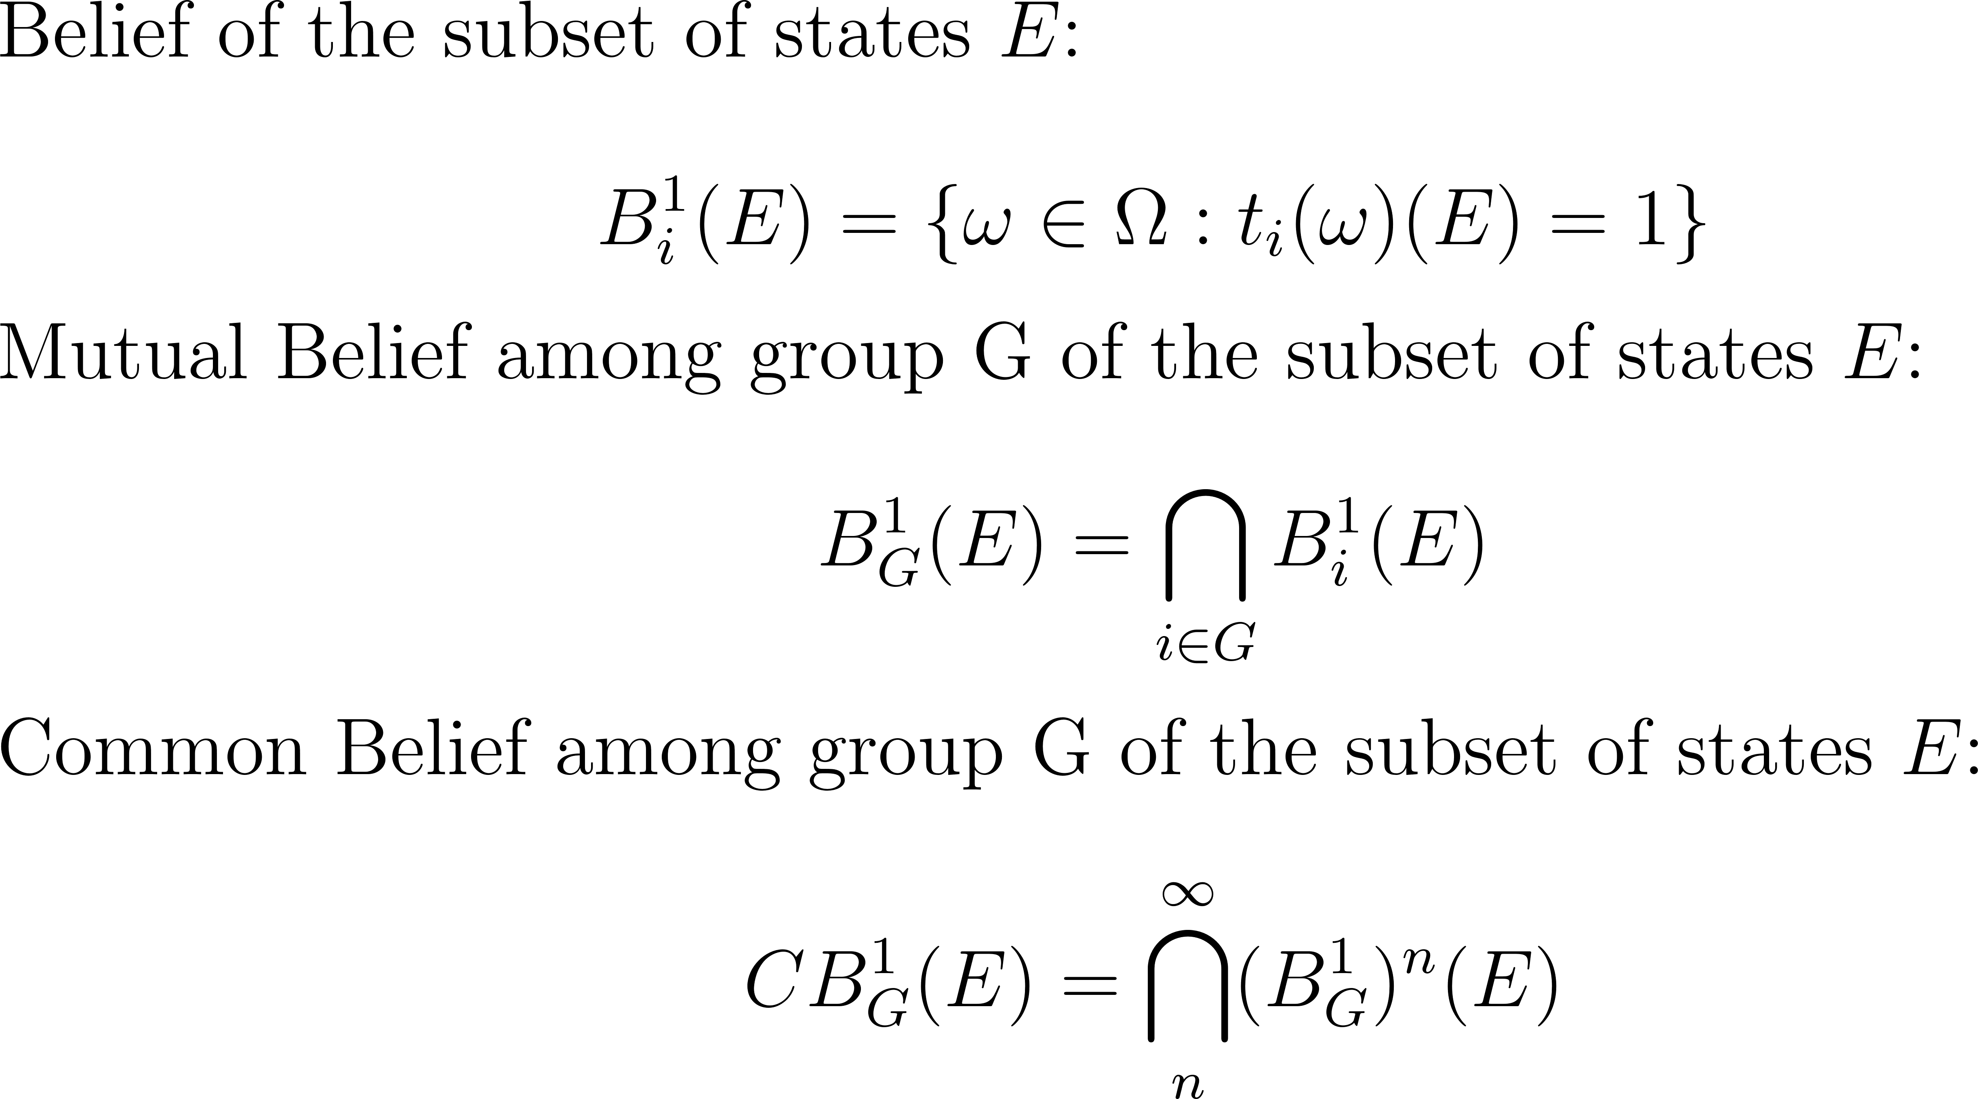
Value Capture:

Slide 16
Value Capture:

Slide 17
Some General Results:

Slide 18
Some General Results:

Slide 19
Summary
Static framework for value creation and value capture under incomplete information and unawareness
Coarse core: Which feasible deals may emerge because of lack of common belief of groups in better alternative deals? (It is not necessarily equilibrium in the sense of rationality and mutual beliefs in demands of value. It is also not rationalizability in the sense of common beliefs in rationality of firms.)
We challenge some received wisdom of standard value capture theory:
Added value is NOT necessarily an upper bound to value capture.
Added value is NOT necessary for value capture.
Show how this must be due to lack of common belief.

Slide 20
Next steps
Characterization of the nonempty coarse core
When can firms profit from strategic factors, capabilities, competencies, abilities, and opportunities under incomplete information and unawareness?
How does strategic disclosure and info/awareness affect value creation and value capture? Biform games with incomplete info and unawareness: extensive-form rationalizability in the non-cooperative stage and the coarse core at terminal information sets.
What do firms learn from no-blocking of others? Repeated cooperative games with incomplete info and unawareness: Learning, discovery, and value-capture in the long run
Value creation and value capture under ambiguity/Knightian uncertainty: comparative statics w.r.t. to ambiguity version
…
Looking for people to join the research program

