Slide 1
Insiders Trading on Unknown Unknowns
Burkhard C. Schipper
Department of Economics,
University of California, Davis
Hang Zhou
School of Finance,
Shanghai University of Finance and Economics

Slide 2
Motivation
Trading of insiders have been studied in market microstructure: Insiders have private information (i.e., known unknowns to other traders)
New in this paper: Insiders have also private awareness (i.e., unknown unknowns to other traders)
Intuition:
fundamental values are often sums of random variables (e.g., equity = assets – liabilities; profit = revenue – costs)
Some traders may be unaware of some line item of the balance sheet or profit & loss
They may miss some terms in the sum of random variables making up the fundamental value.
Consequently, they may interpret signals about the fundamental and the information contained in prices differently.
Insiders may not just have better information but also more awareness.
How does it affect information aggregation in markets, trading strategies, market depth, price precision, price volatility, trading volume etc.?
Insiders typically do not have an incentive to disclose private information but do they have an incentive to raise awareness of others traders?

Slide 3
Related Literature
CARA normal asset markets in market microstructure and REE: Vives (2008, Chapter 4.2.1), Kyle (1989), Hellwig (1980), Grossman and Stiglitz (1980), Grossman (1976), Admati (1985), Diamond and Verrechia (1981), …
Unawareness: Heifetz, Meier, and Schipper (2013), Meier and Schipper (2014a)
Speculation under unawareness: Heifetz, Meier, and Schipper (2006, 2013), Galanis (2018), Meier and Schipper (2014b)
Financial markets with unawareness: Lui (2017), Auster and Pavoni (2020), Gui, Huang, and Zhao (2020), Carvajal et al. (2021)
Financial literacy and financial awareness: e.g., Guiso and Jappelli (2005)
Neglected risks: Gennaioli, Shleifer, and Vishny (2012)
Neglected informational content of prices: e.g., Eyster, Rabin, and Vayanos (2019), Zhao (2020)
Competitive markets with unawareness: Modica, Rustichini, and Tallon (1998), Kawamura (2005), Teeple (2021)

Slide 4
Model

Slide 5
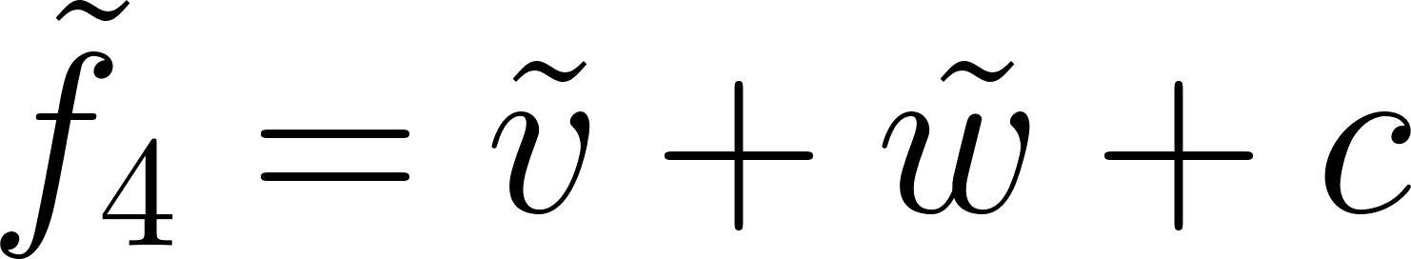




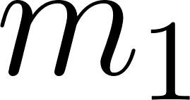
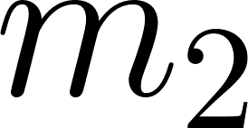
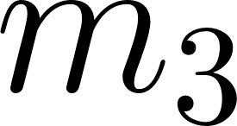
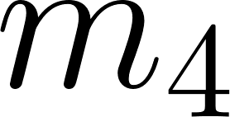
●
●
●
●

Slide 6
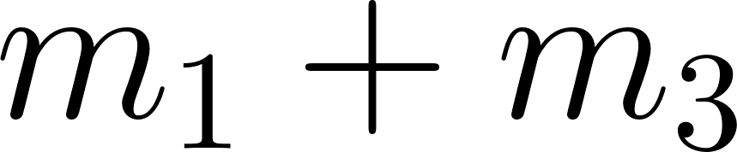
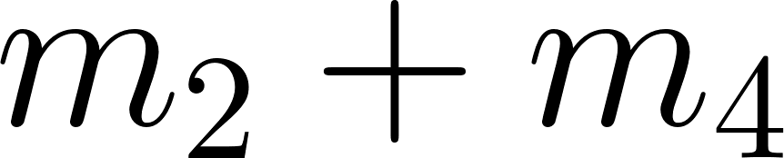
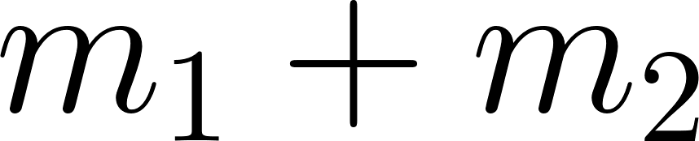
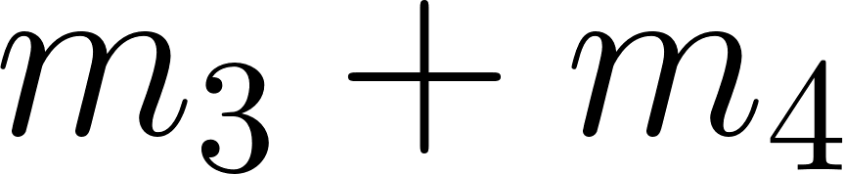
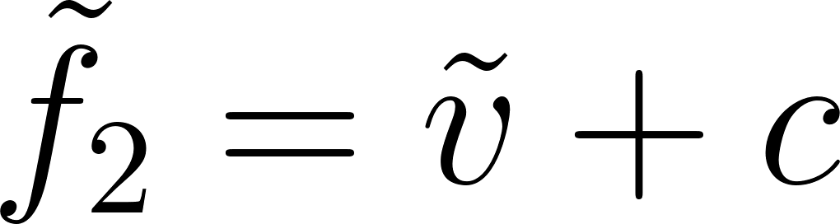
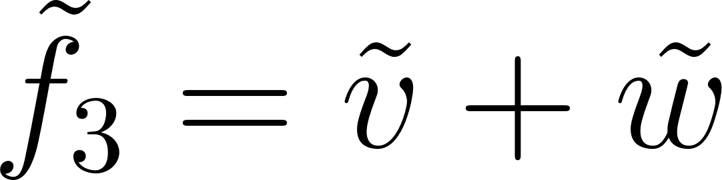
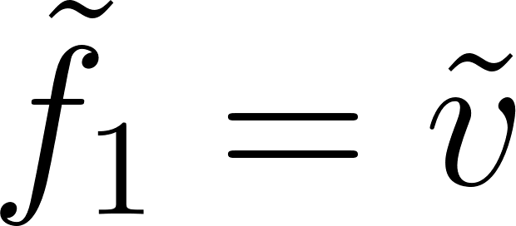
●
●
●
●
●
●
●
●
●

Slide 7
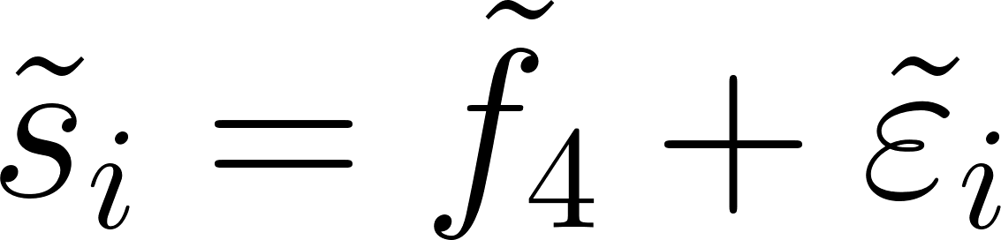
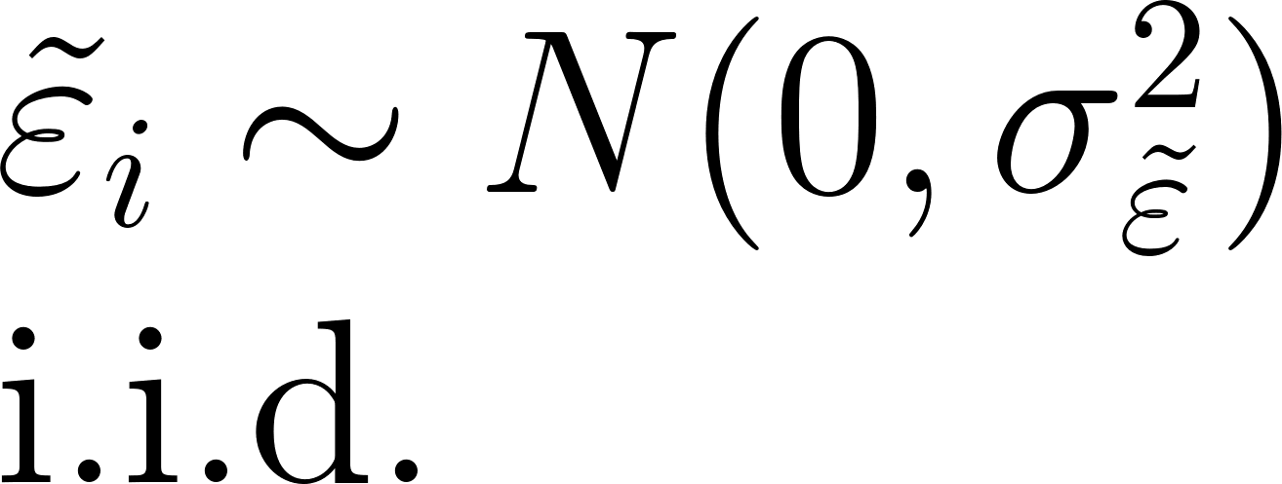
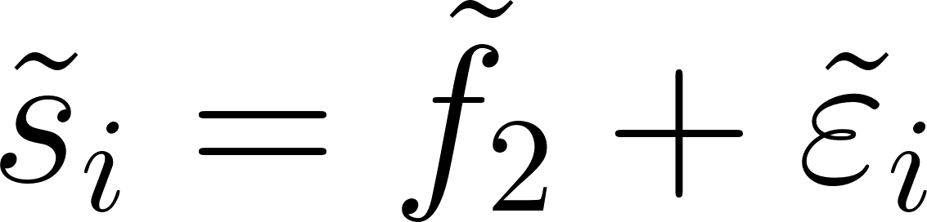
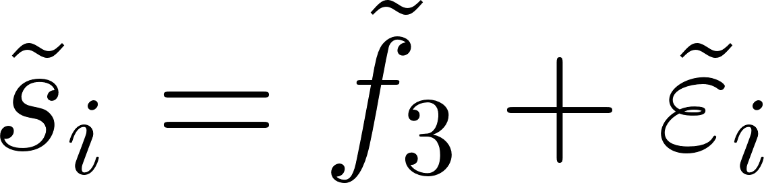
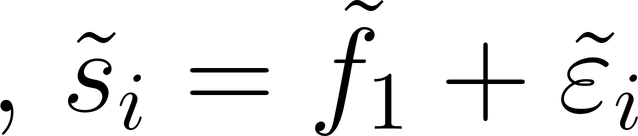
●
●
●
●
●
●
●
●
●

Slide 8
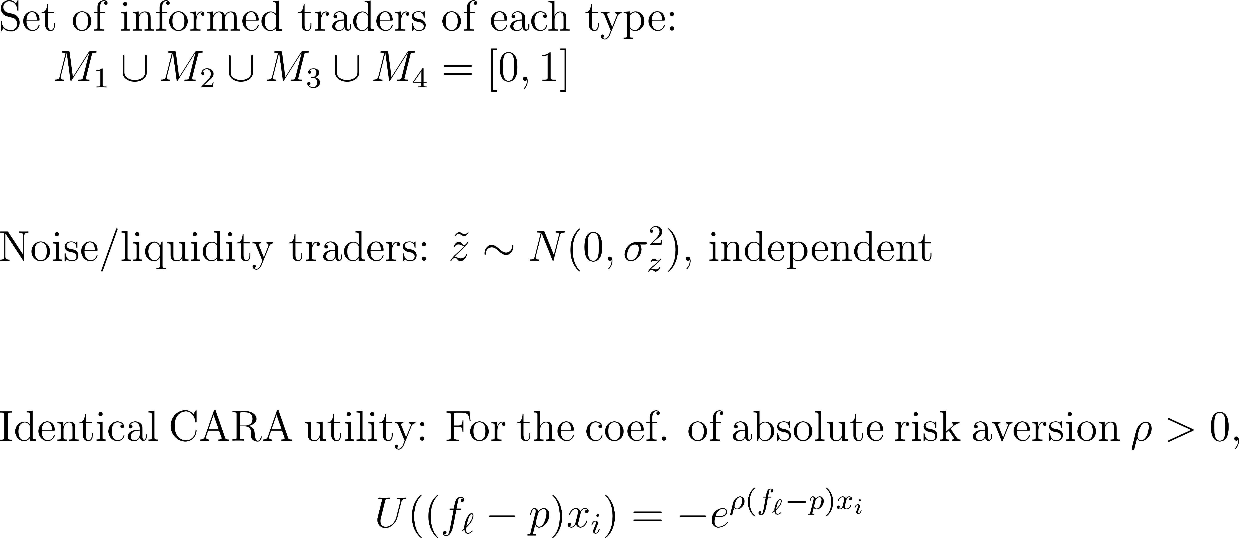
Model

Slide 10
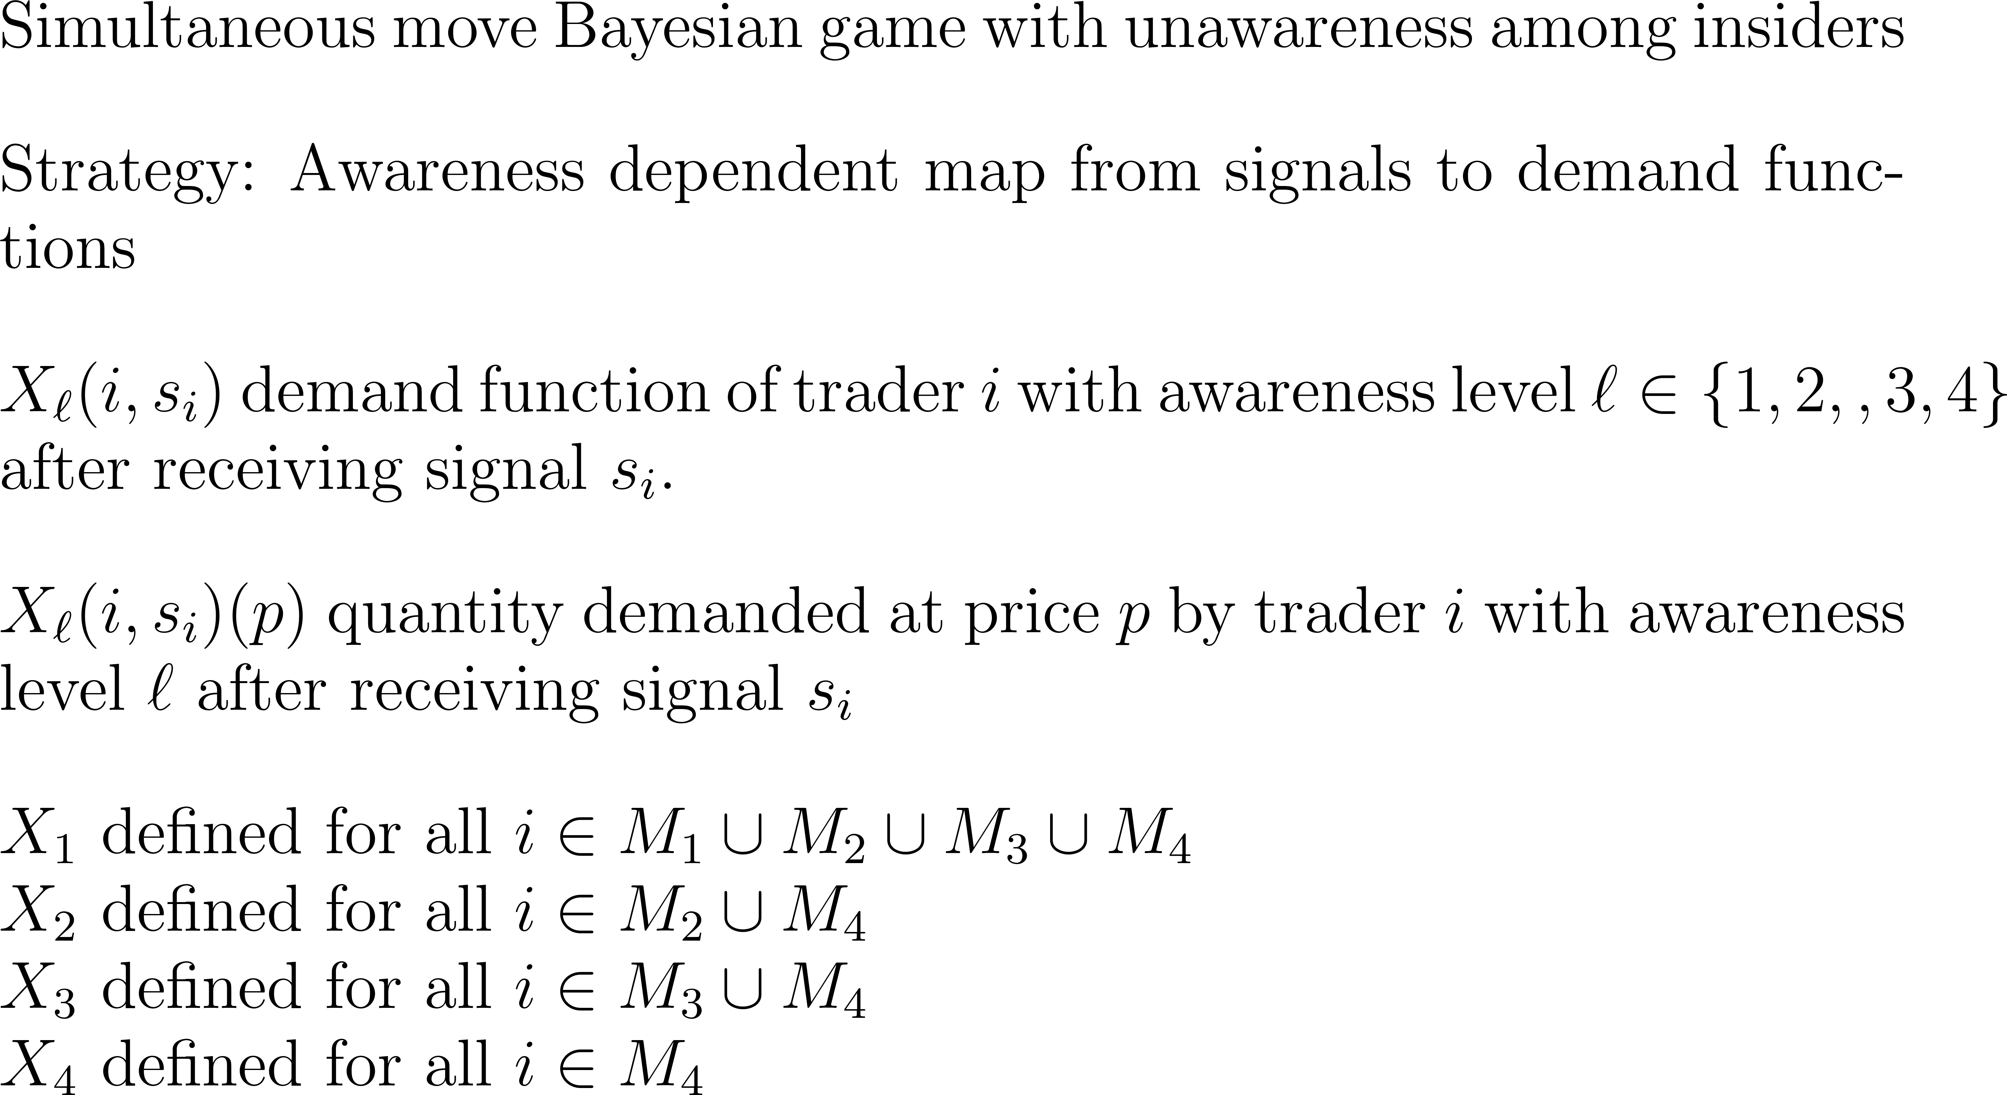

Slide 11
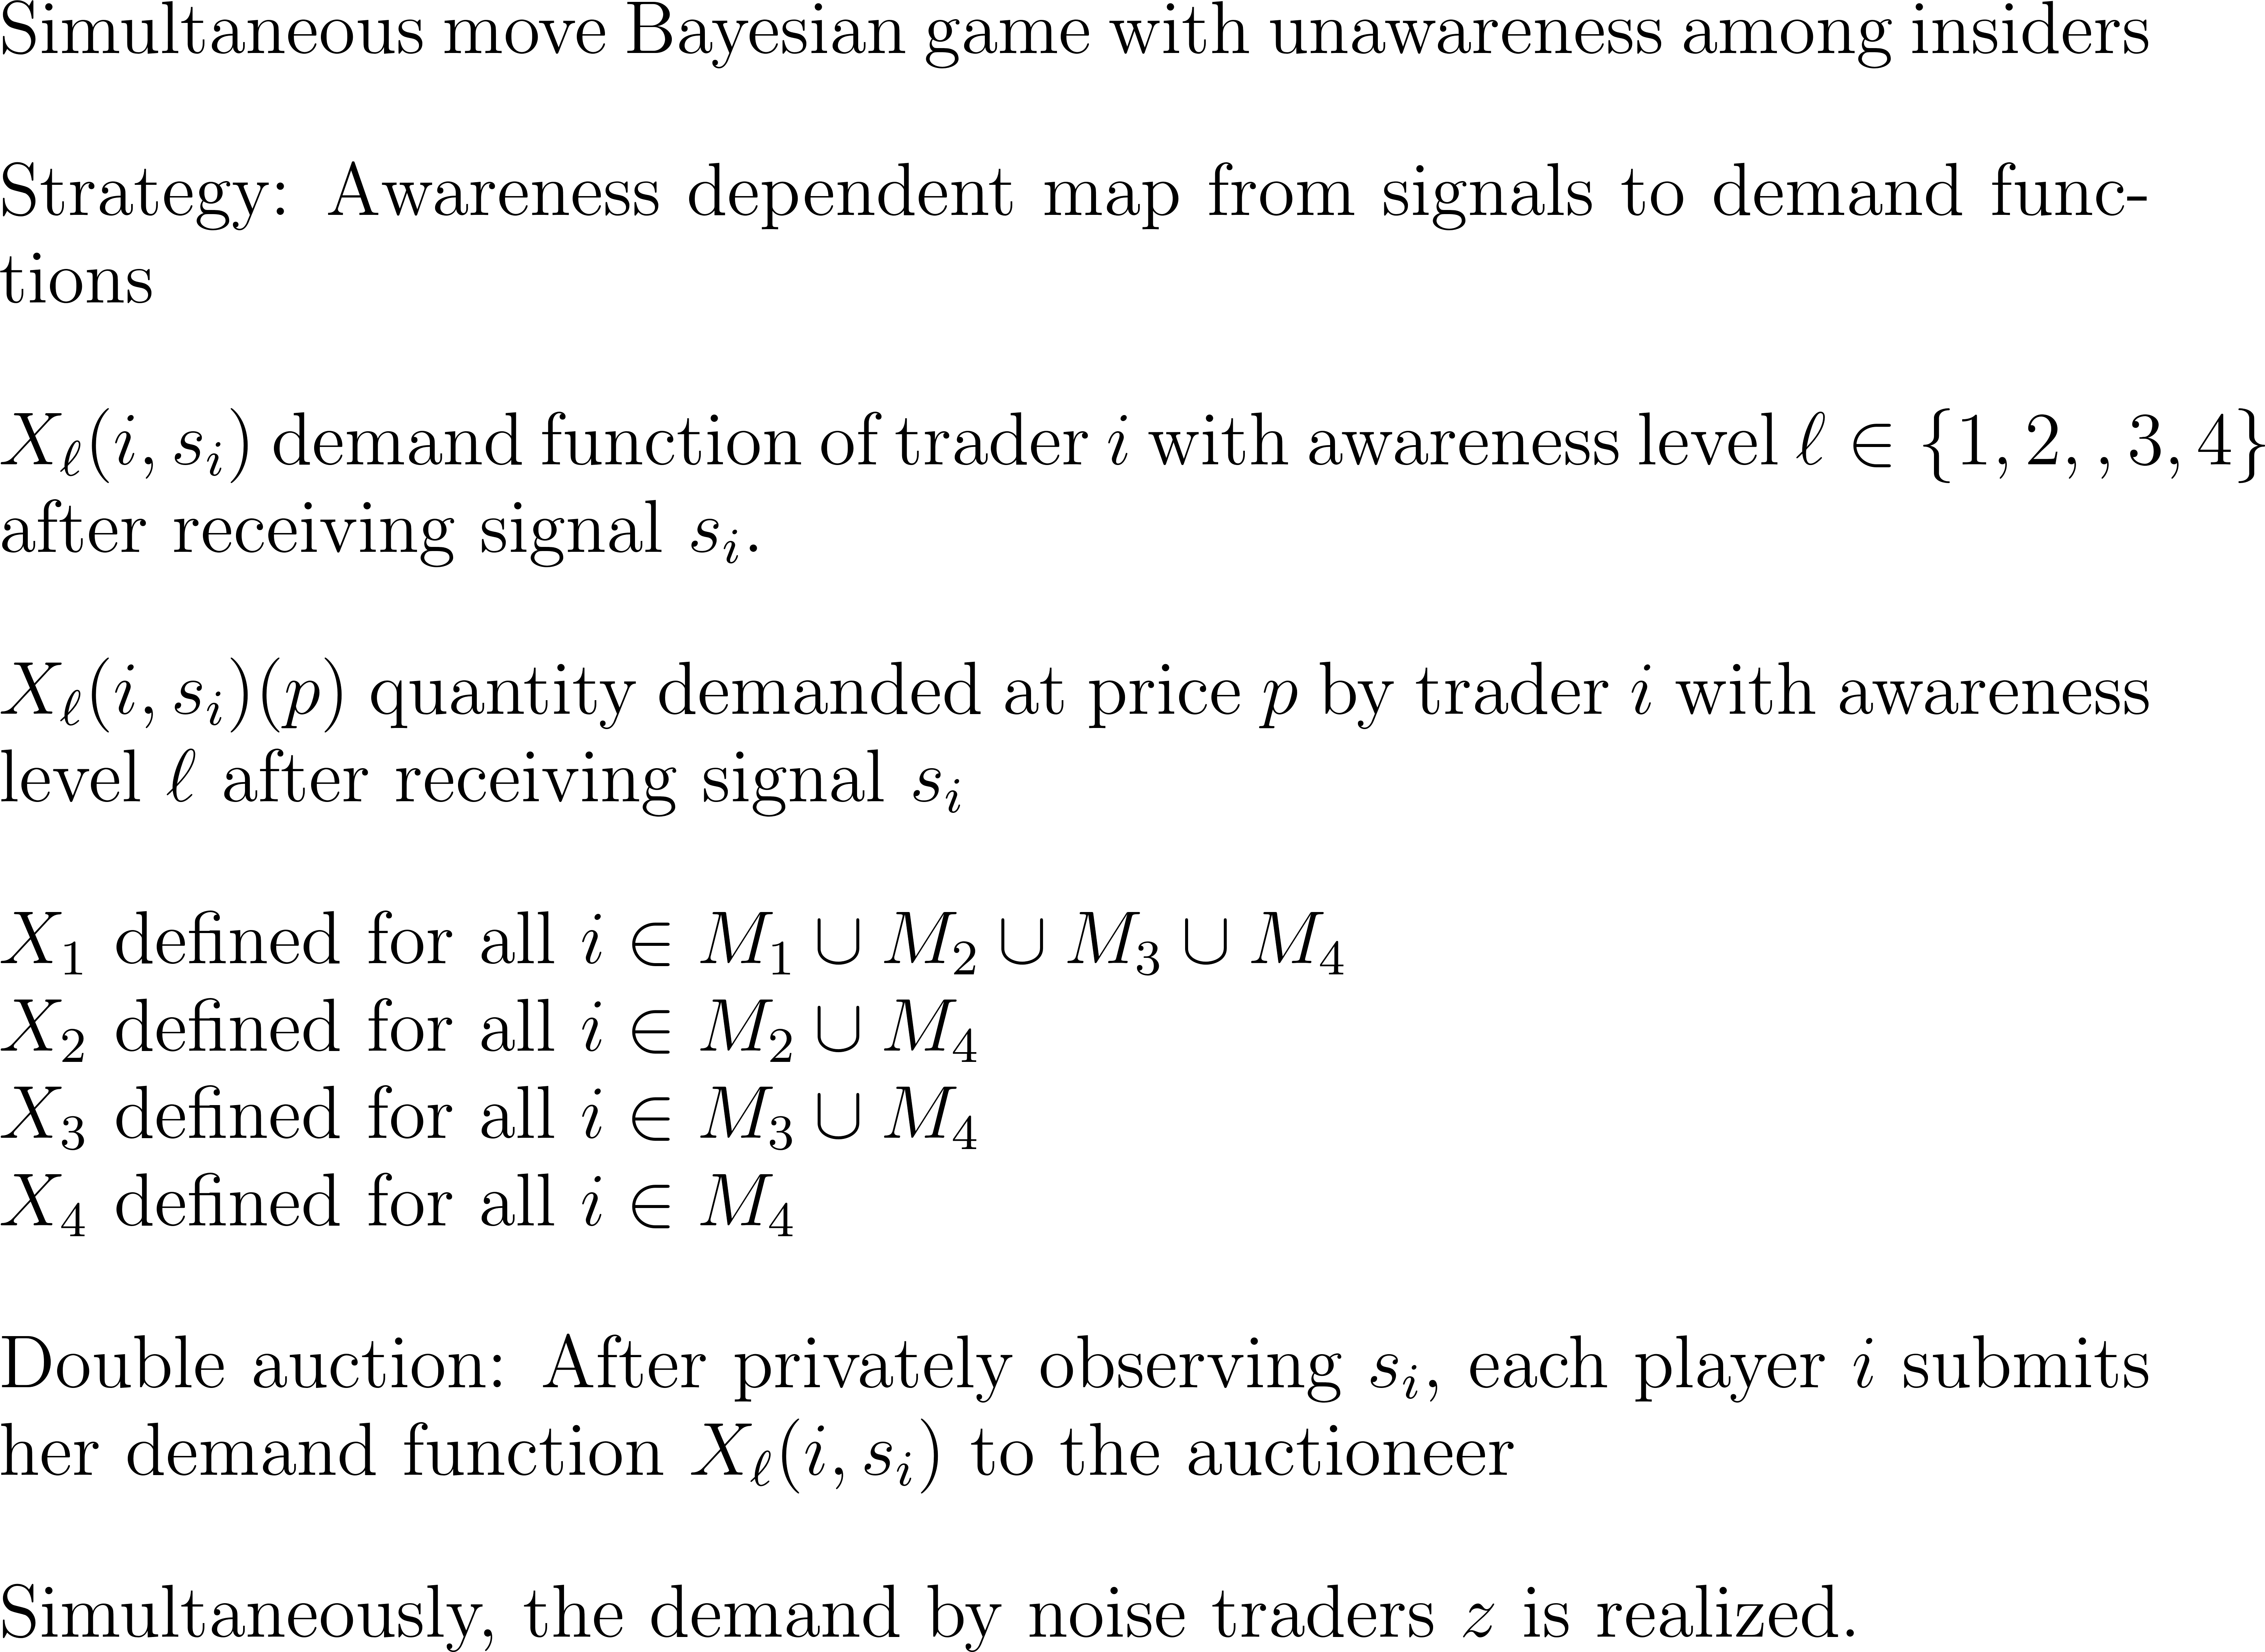

Slide 12
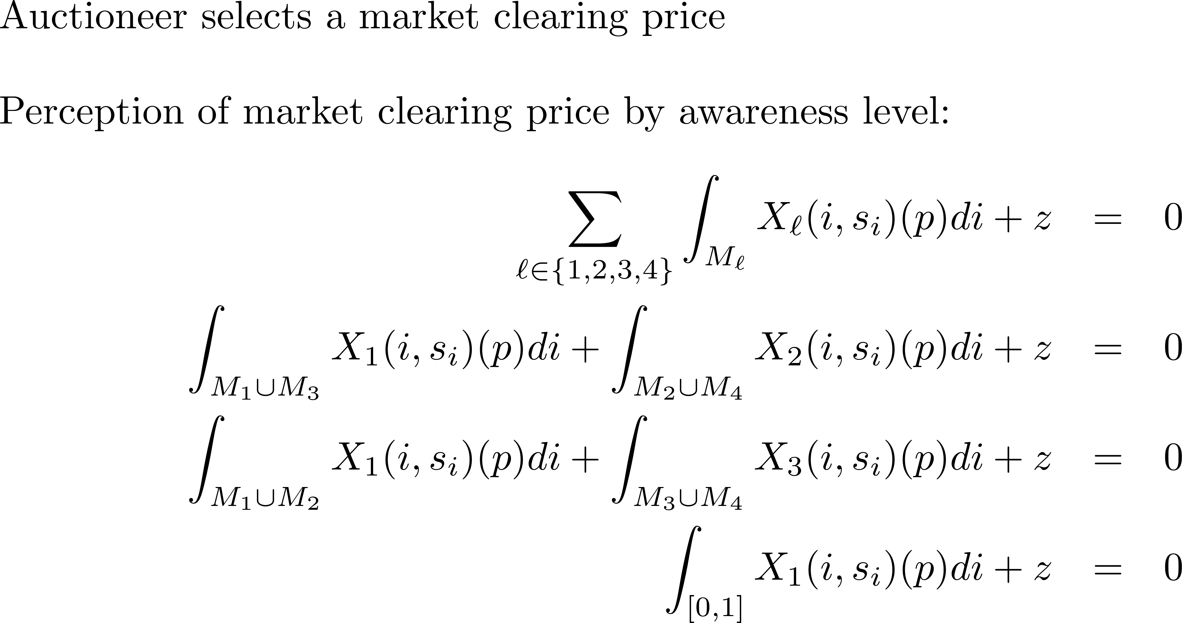

Slide 13
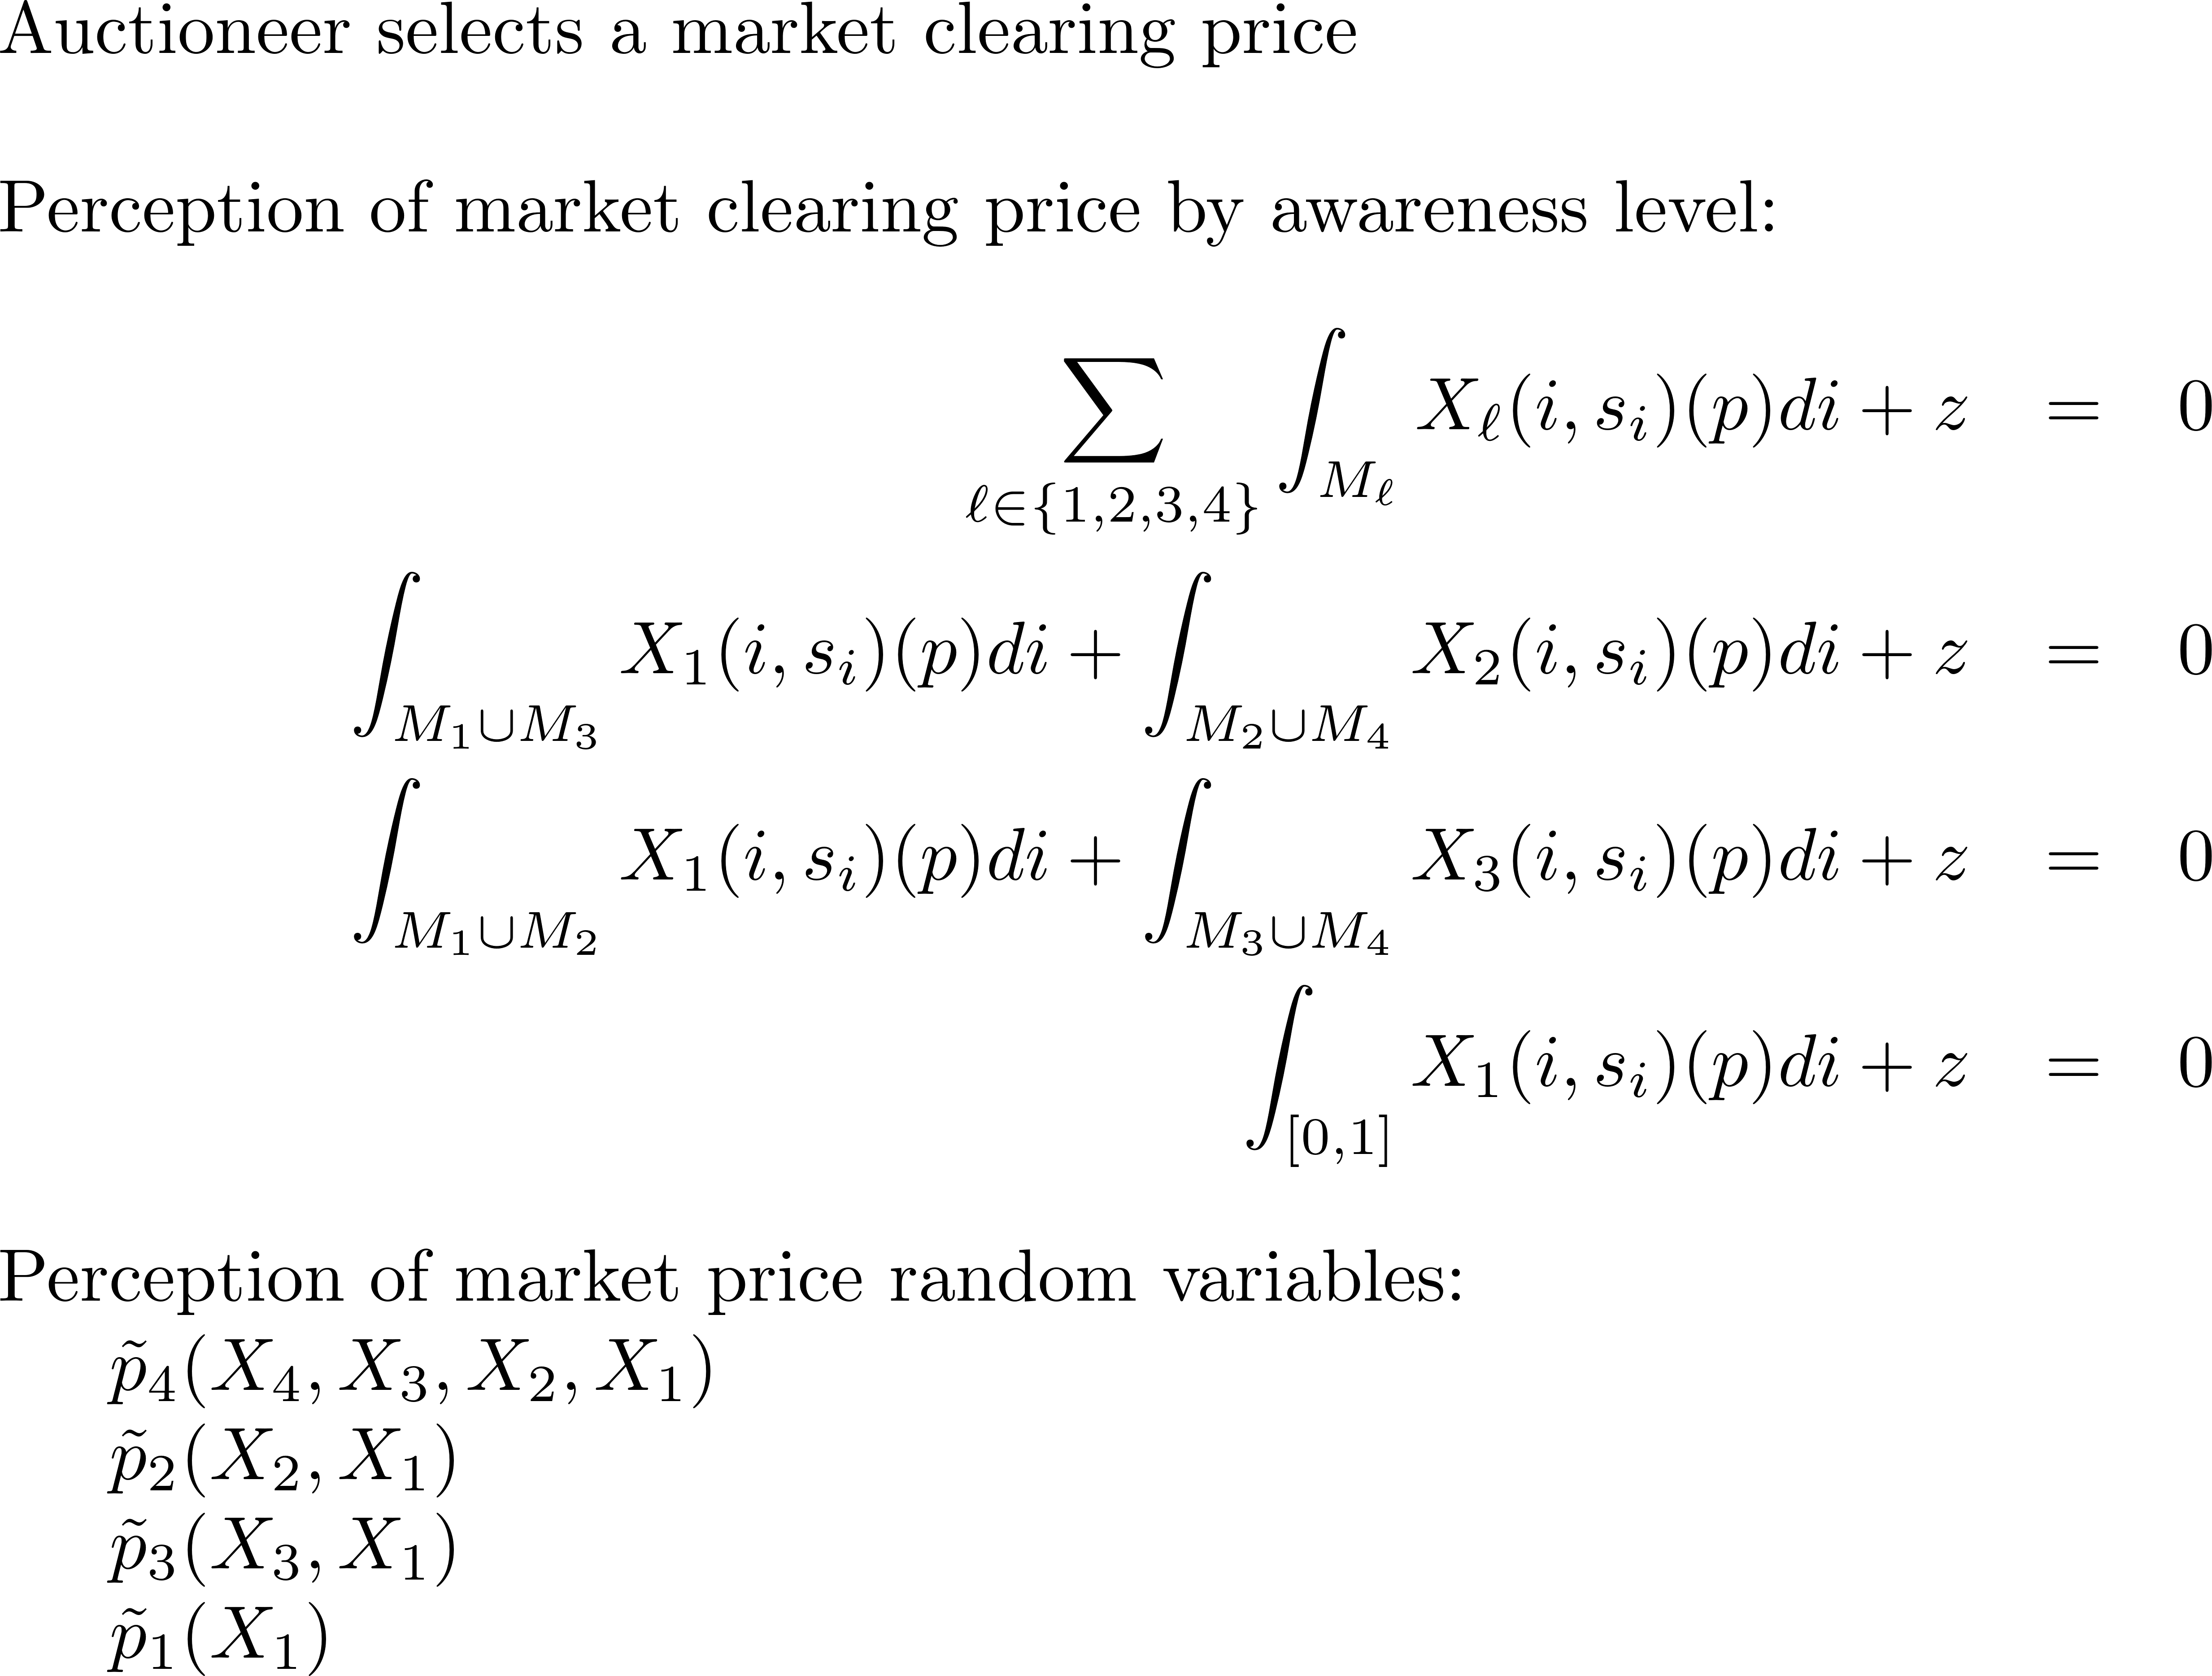

Slide 14
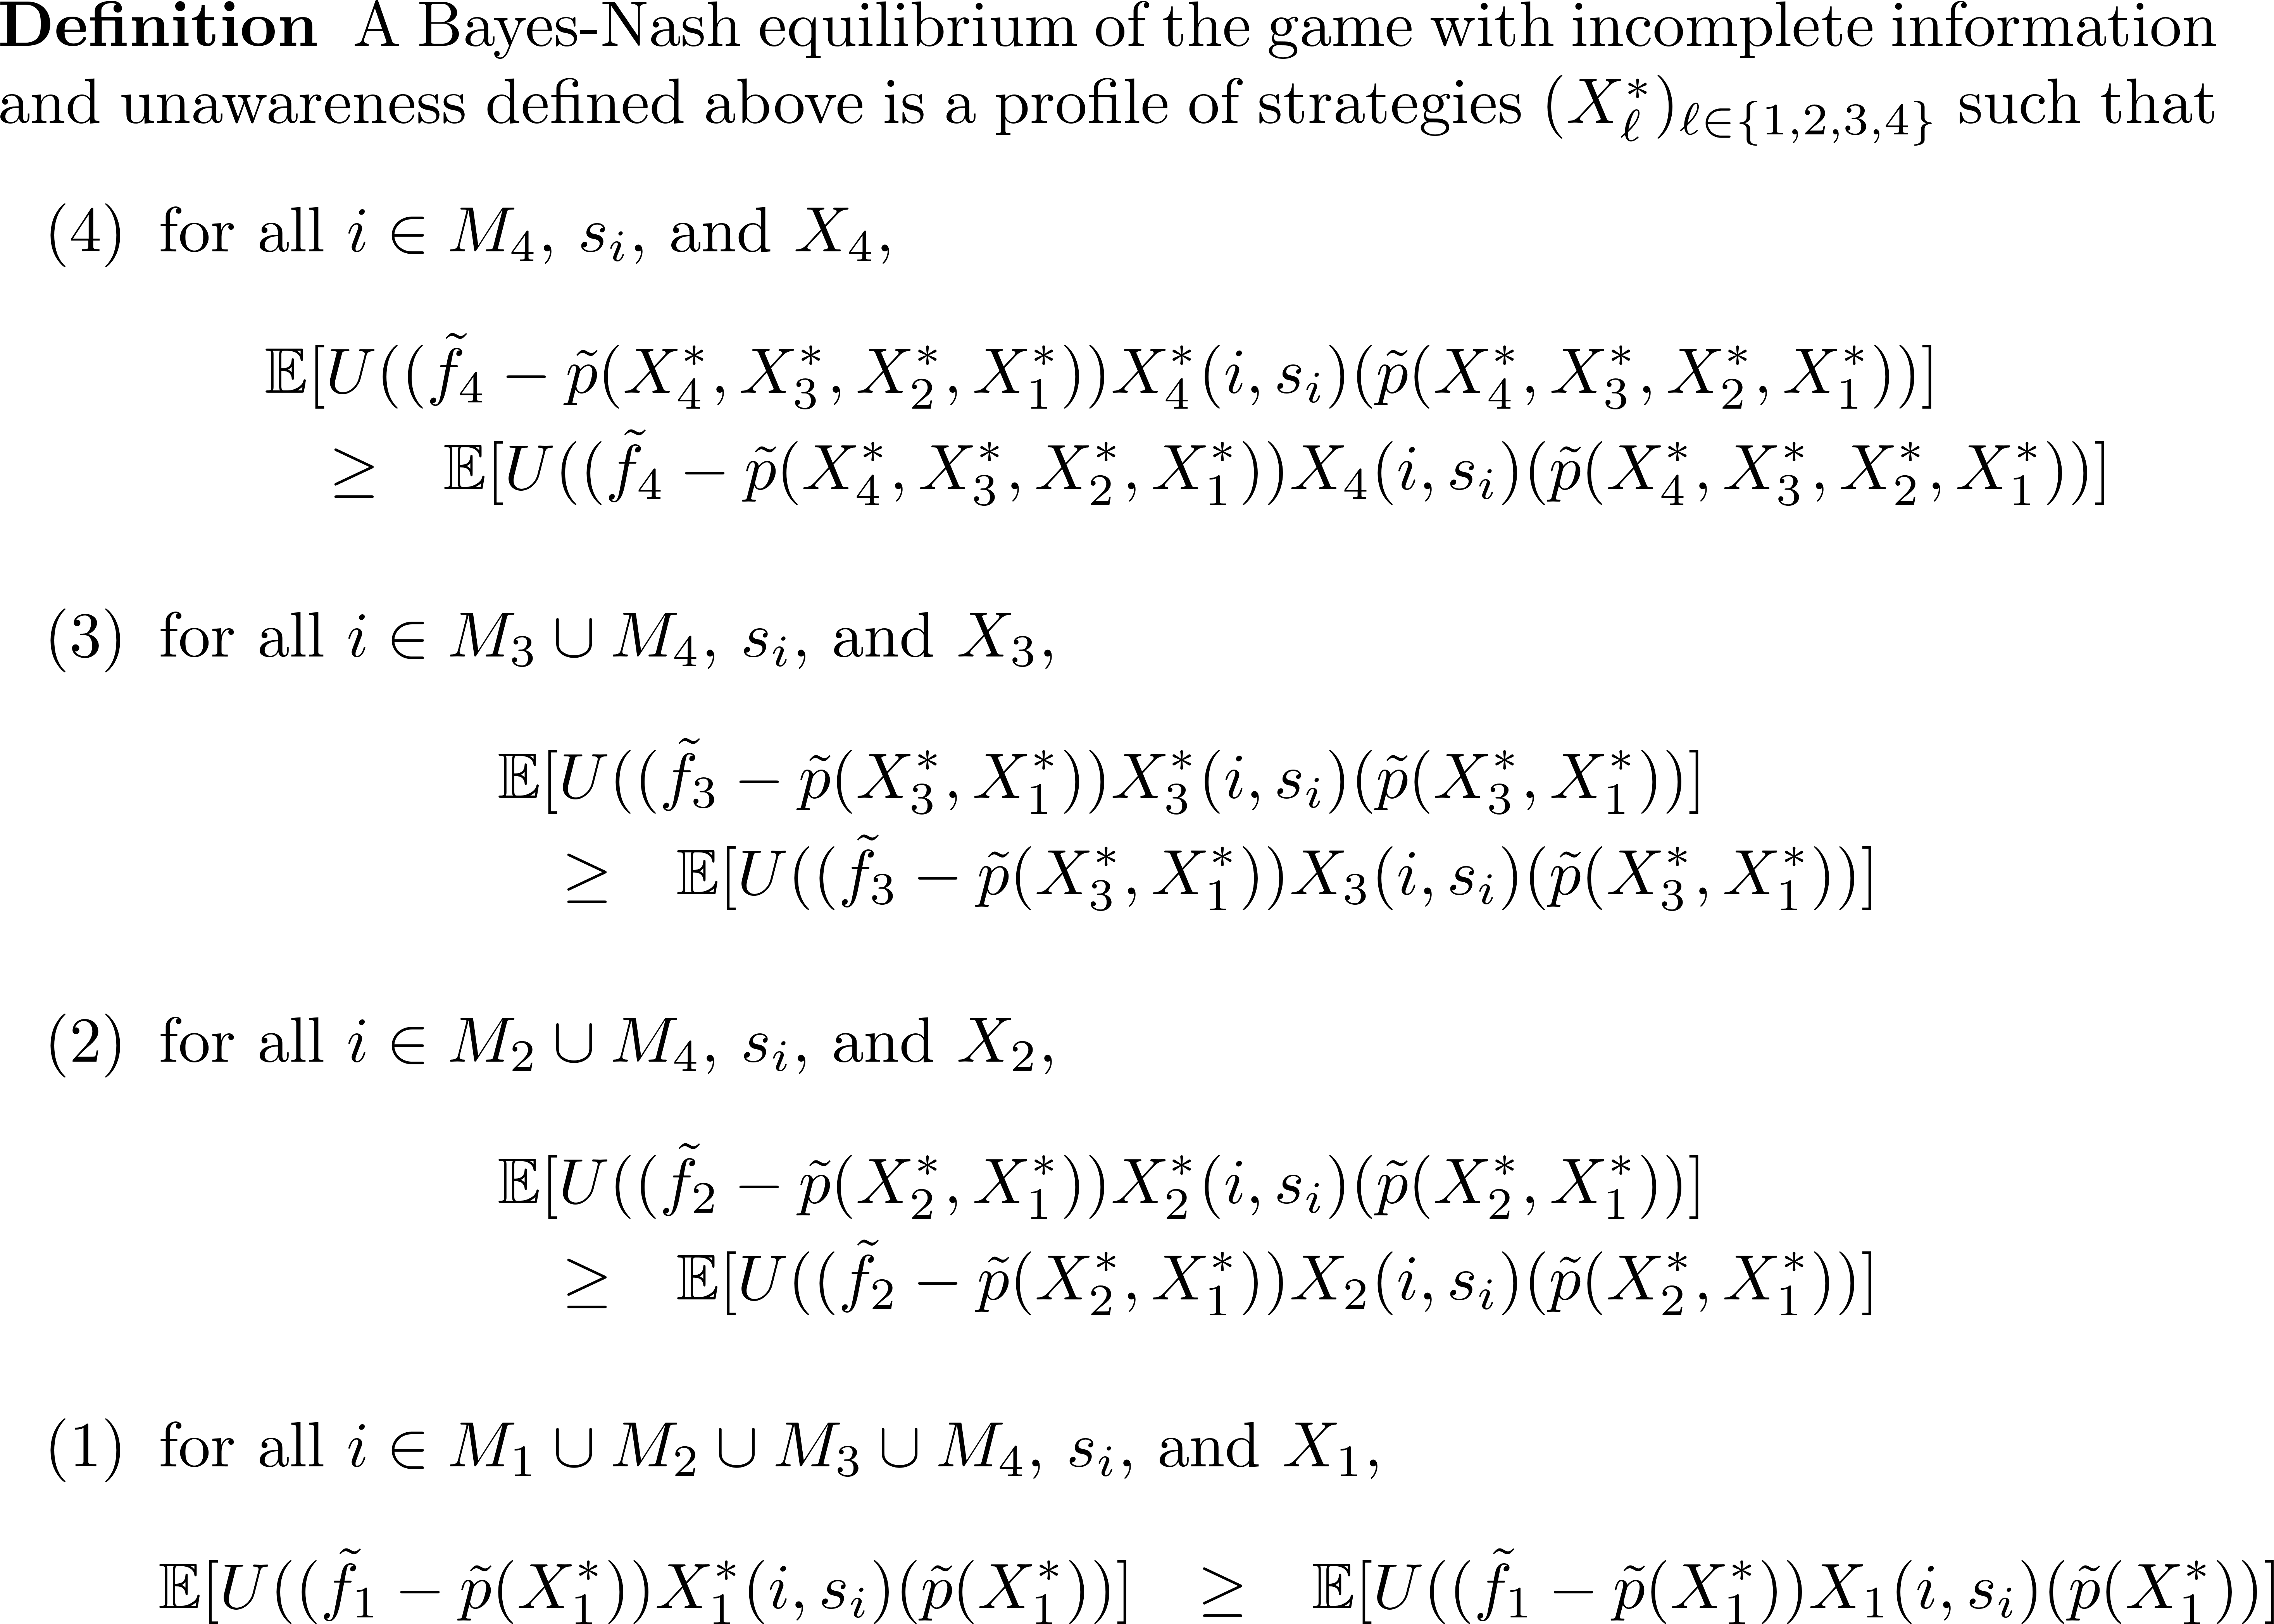

Slide 15
Results
Full characterization of unique Bayes-Nash equilibrium in symmetric linear strategies in closed form
Comparative statics w.r.t. primitives
Comparison across awareness levels
Measures of “market quality” across awareness levels and comparative statics w.r.t. measures of awareness types: market depth, price precision, price volatility, expected trading volume

Slide 18
Outline of the Proof of Equilibrium Characterization:
Compute equilibrium among lowest awareness level traders
Linear strategies imply equilibrium price random variable via market clearing
Use projection theorem for normally distributed random variables to get conditional variance and expectations of fundamental (conditional on signal and price)
Expected CARA takes mean-variance form
Derive FOC
Identify coefficients of linear strategies
Repeated at higher awareness levels taking into account equilibrium strategies of lower awareness level traders.

Slide 19
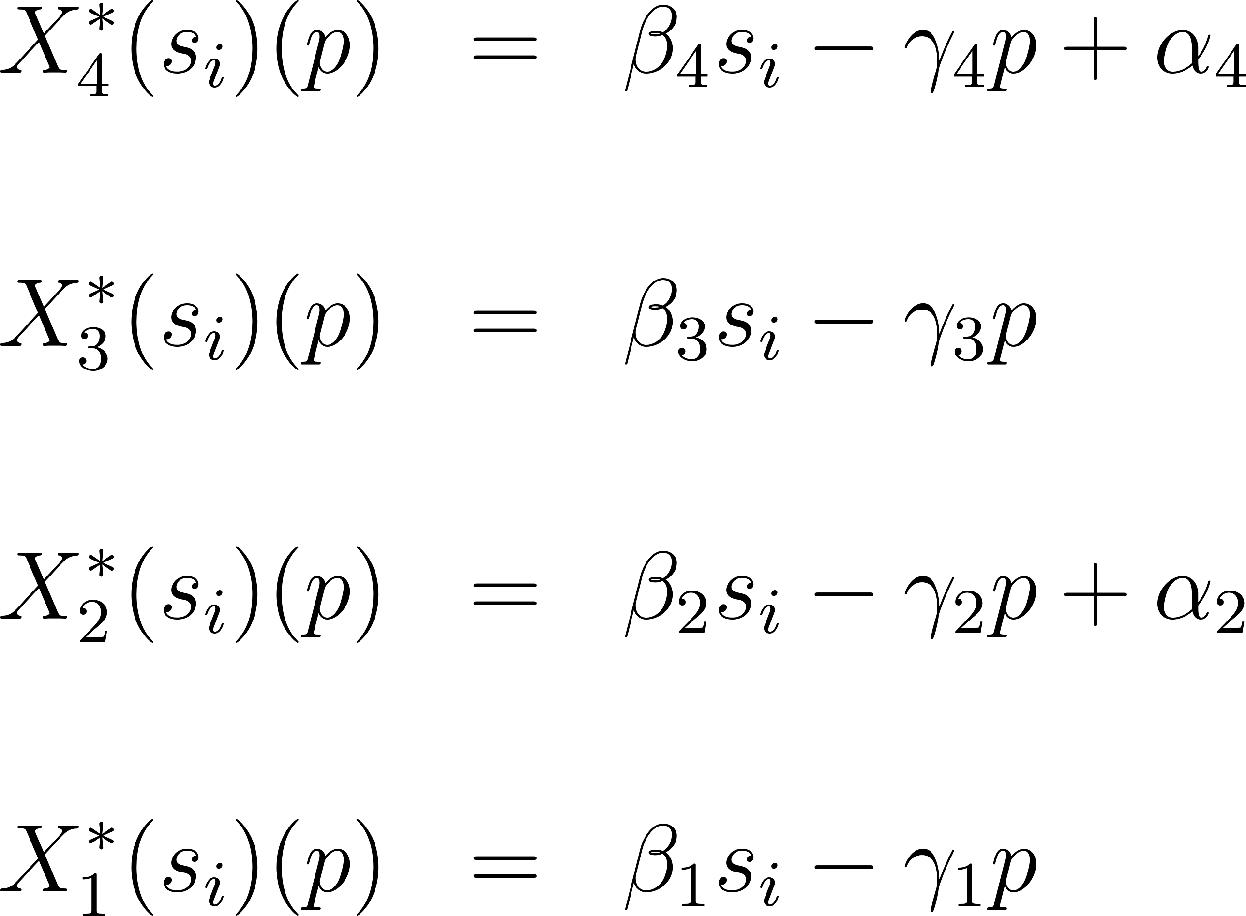
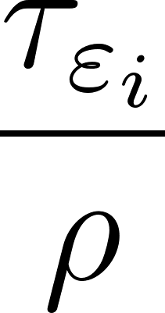
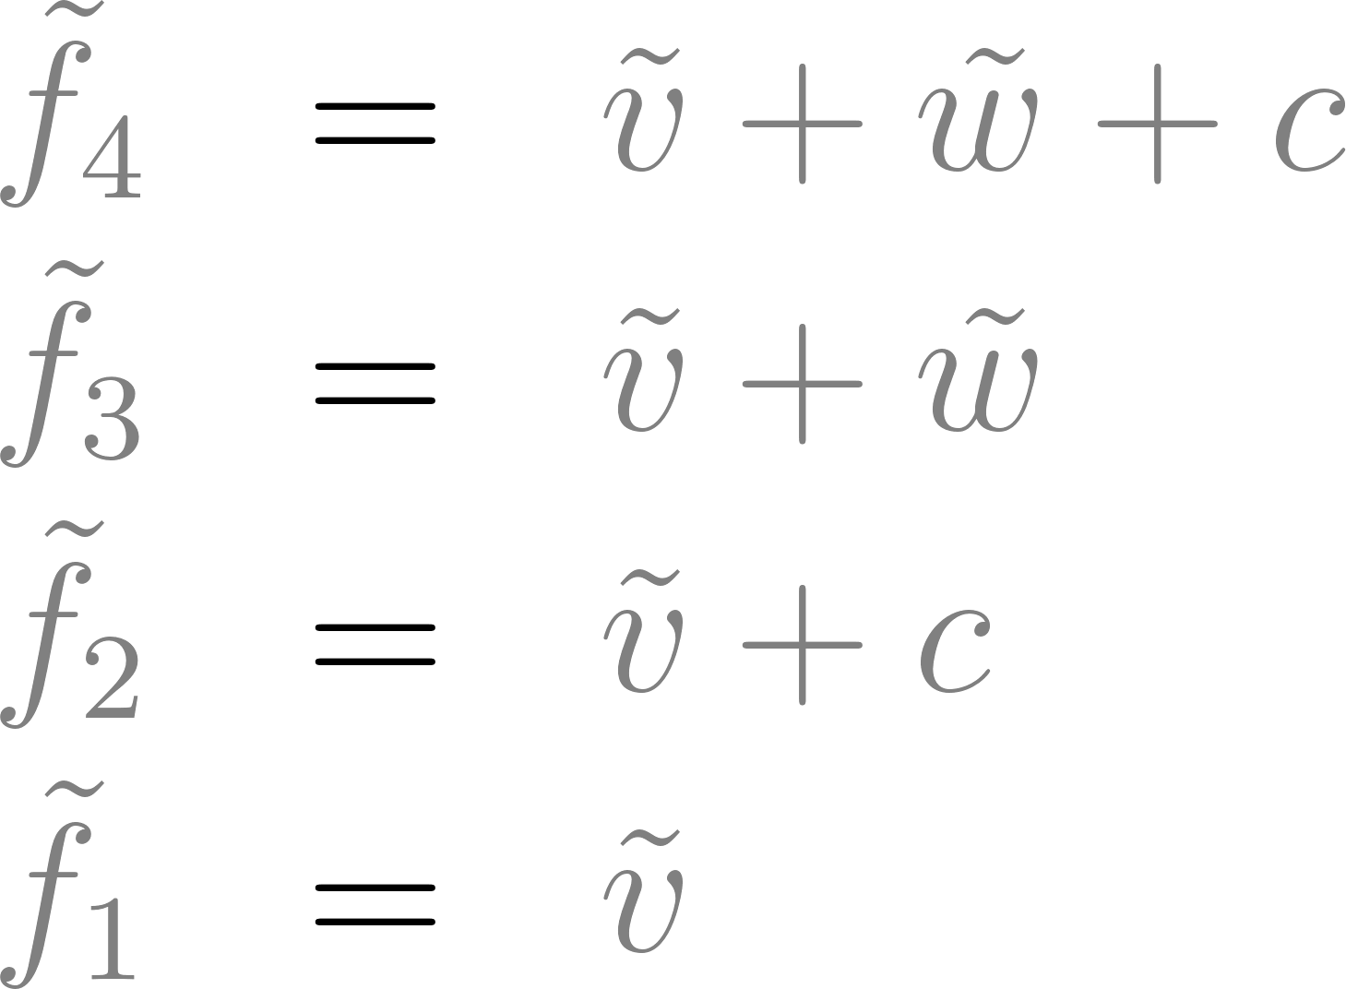
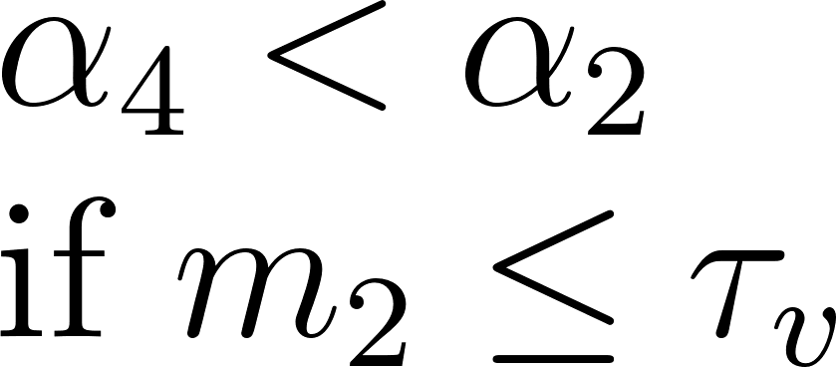
Equilibrium strategies:
Types 3 and 4 perceive same variance of the fundamental
Upwards sloping demand curve if σ_{w}² sufficiently larger than σ_{v}²
=
=
=
<
Types 1 and 2 perceive same variance of the fundamental
Downwards sloping demand curve; overreaction to prices
=
=
Common understanding of noise in signal. Although they misperceive the fundamental and hence the signal, they do not realize this.
=

Slide 20
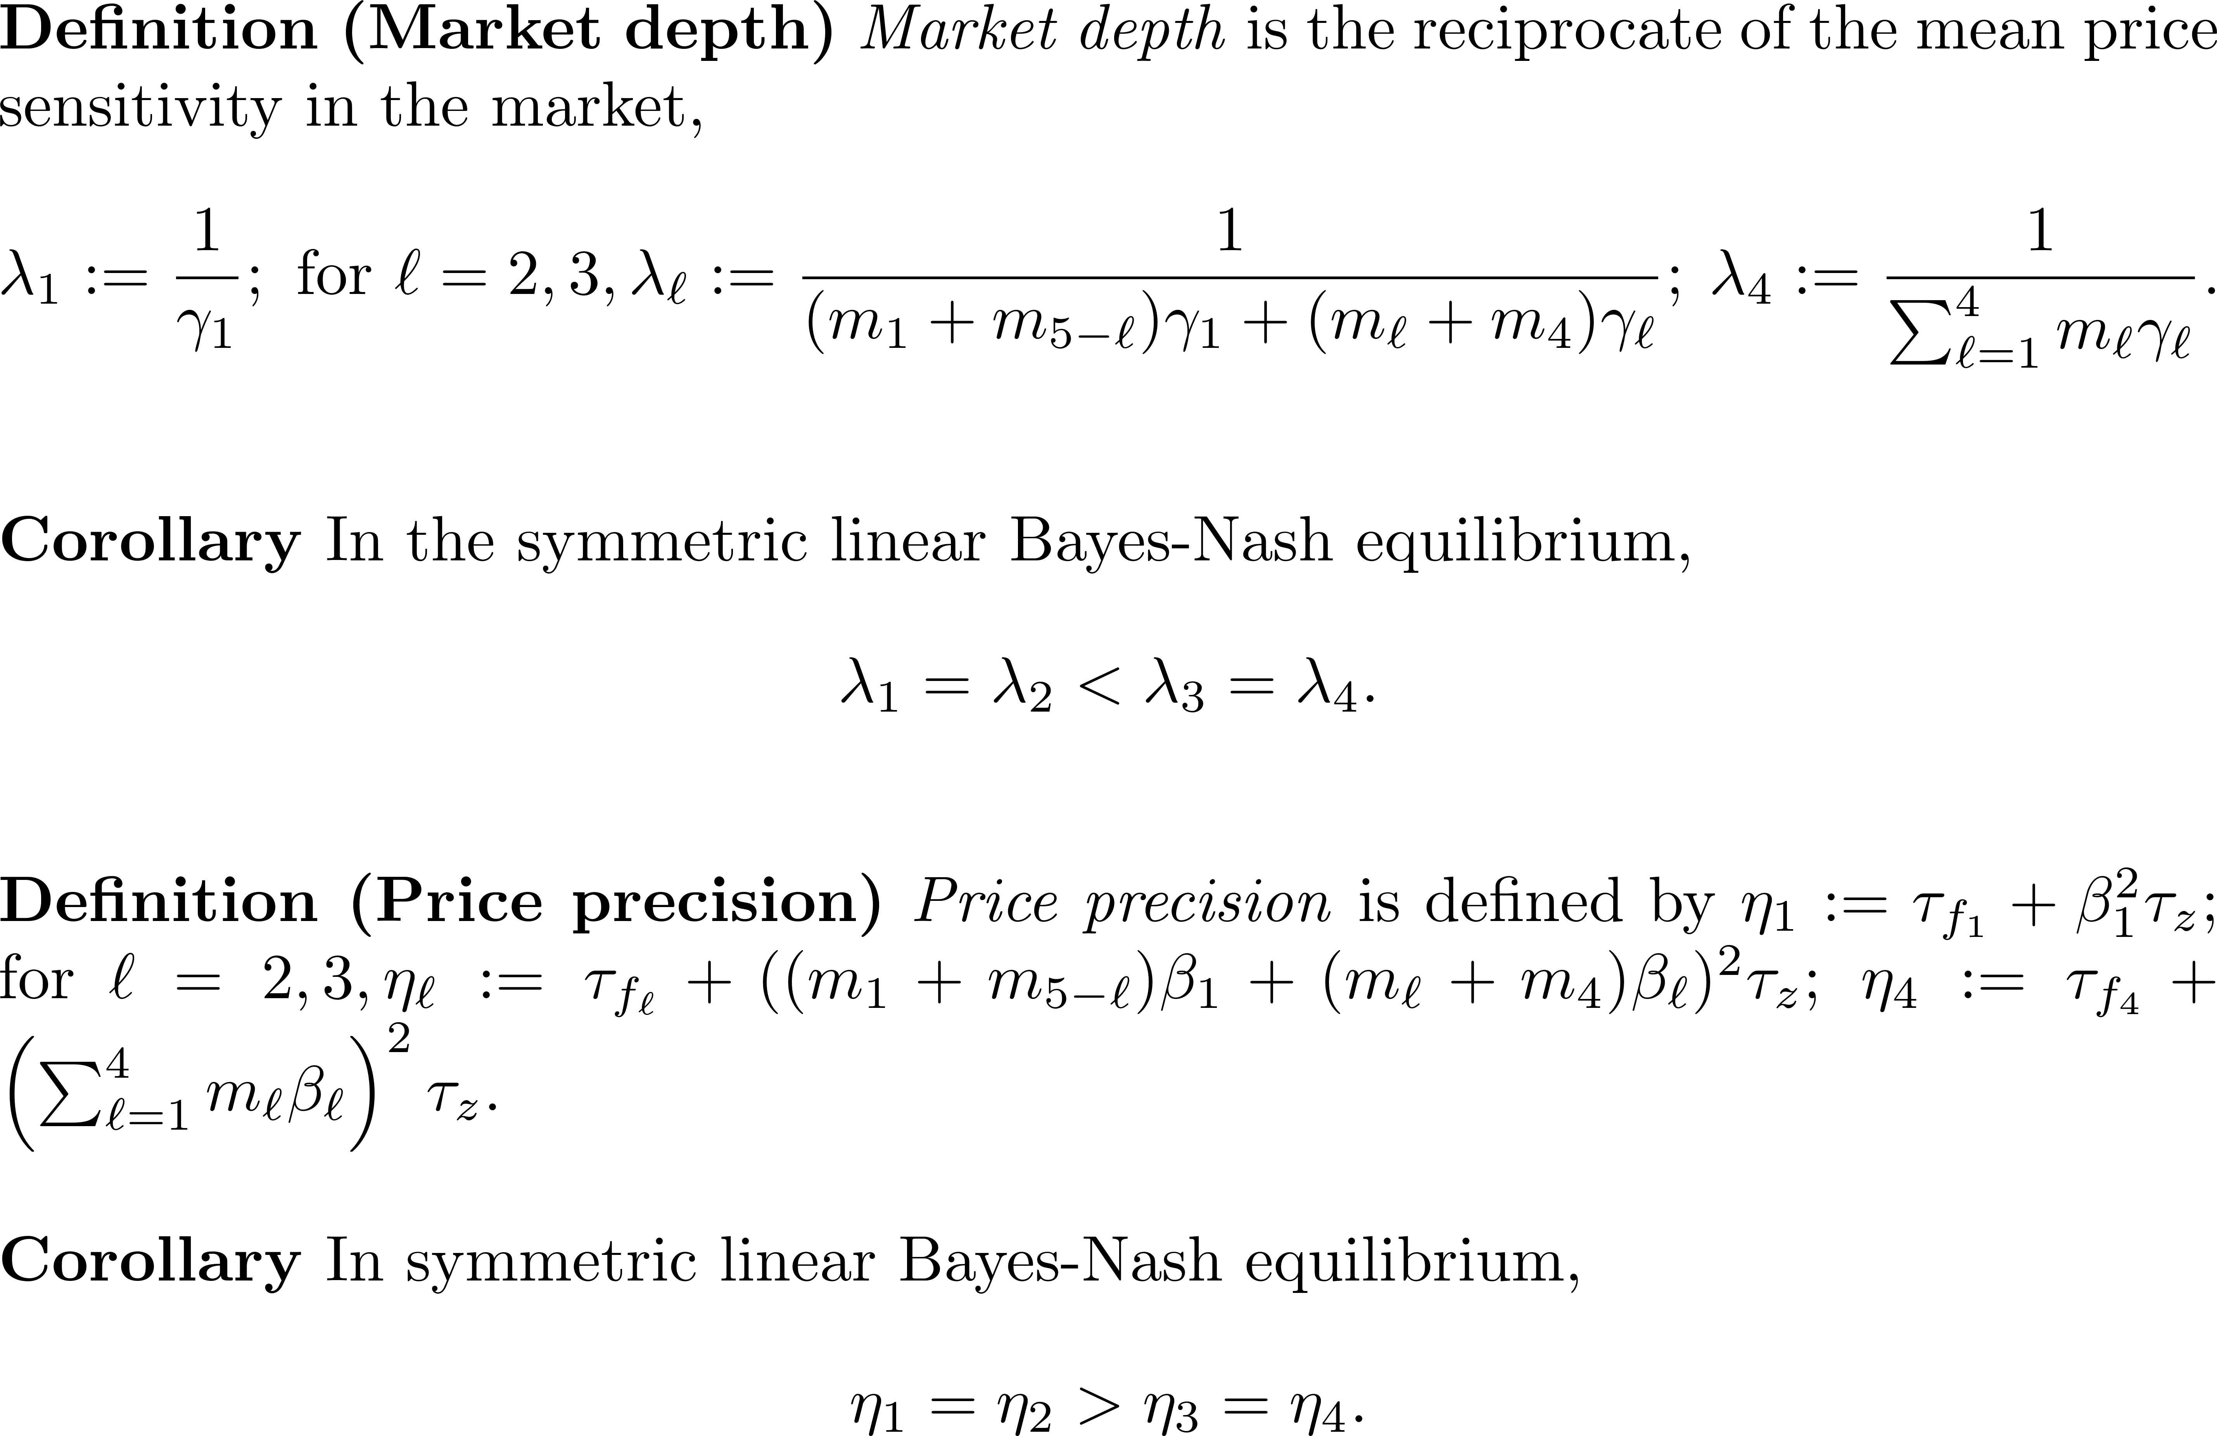
More aware traders have an opposite effect on price precision than more informed traders.

Slide 21
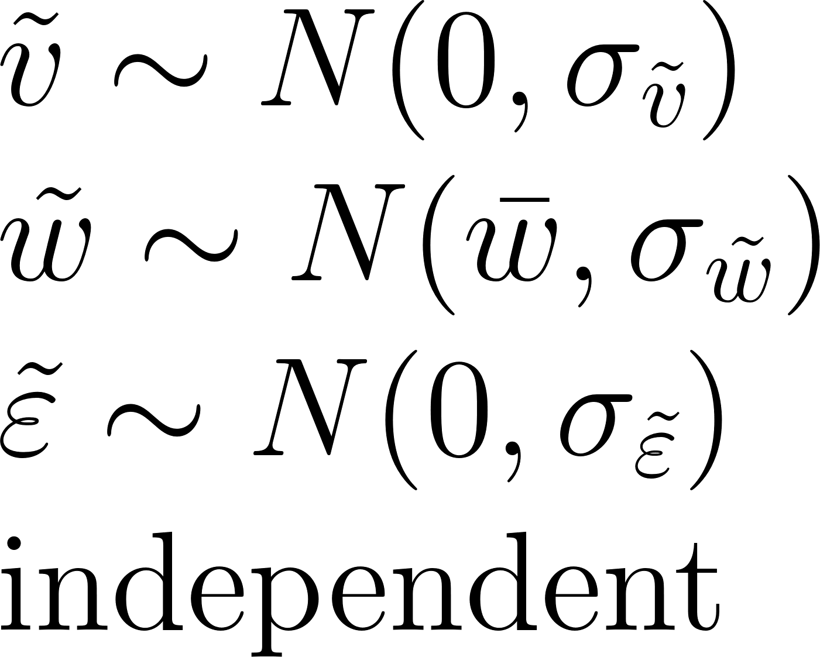


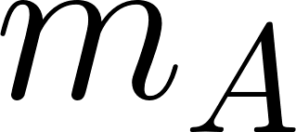
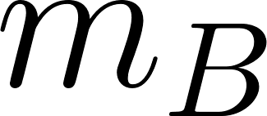
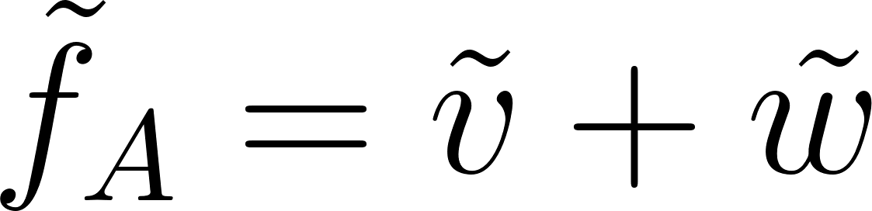
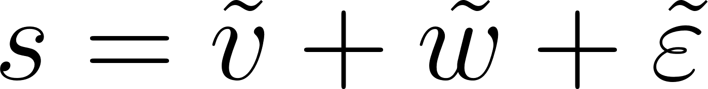
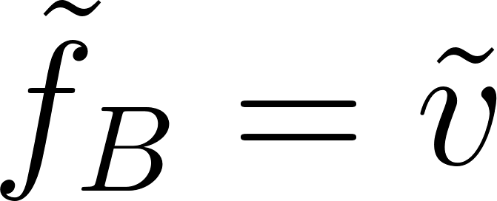
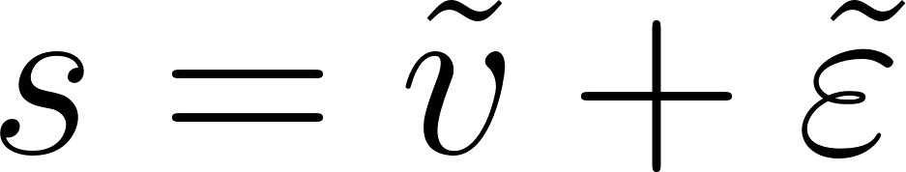
Incentives to Raise Awareness
Simplified model
●
●
●
Common signal
Different interpretation

Slide 22
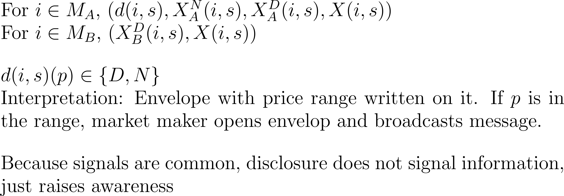

Slide 23
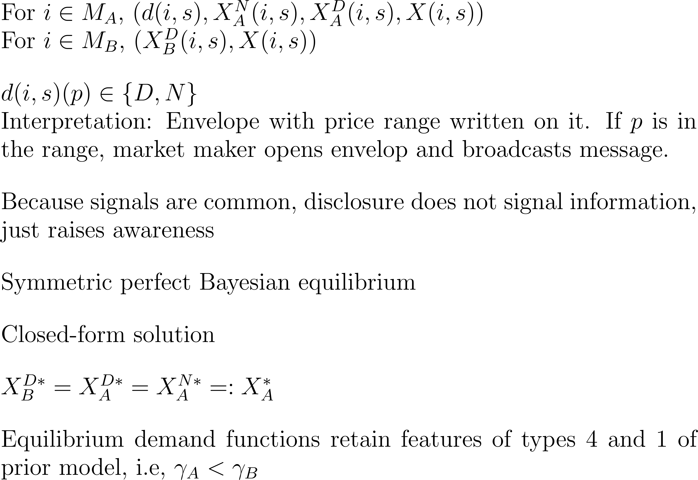

Slide 24

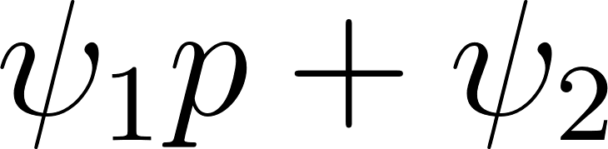
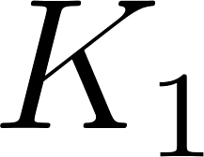
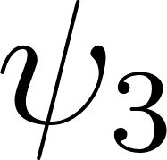

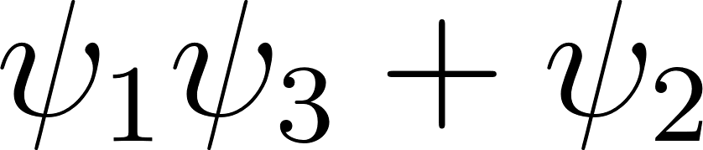
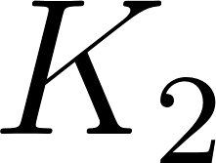
Do type A traders disclose awareness and if yes when exactly?
Full characterization:

Slide 25

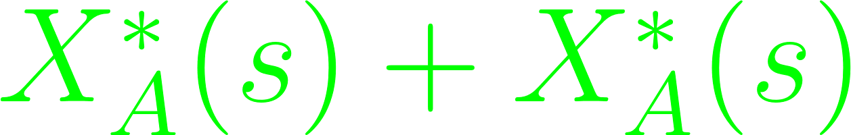

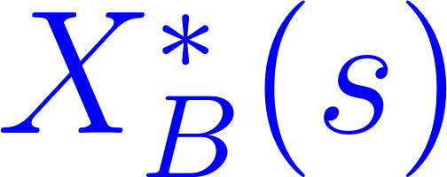
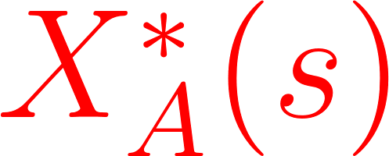
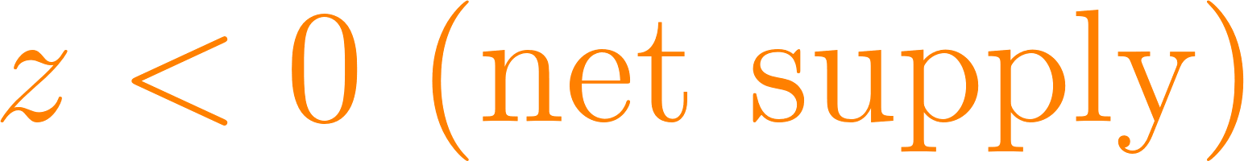

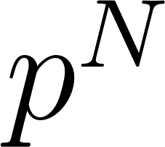
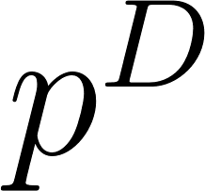

Intuitive Proof a la ECON 1
Disclose

Slide 26
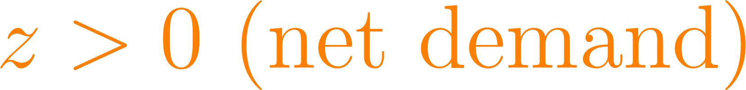
Intuitive Proof a la ECON 1
Disclose

Slide 27
Intuitive Proof a la ECON 1
Disclose
Disclose

Slide 28
Do type A traders disclose awareness and if yes when exactly?
Full characterization:

Slide 29
Conclusions
Unawareness is easy to study in market microstructure models once the unawareness model is set up
Surprisingly, traders react identically to signals irrespective of their awareness level.
Less aware traders overreact to prices.
More aware traders may become momentum traders.
Some received wisdom w.r.t. insiders “with better information” does not extent to insiders “with more awareness” (e.g., price precision)
Aware insiders may want to raise the awareness of others (in contrast with disclosure of information)
…?

Slide 30
Bonus slides

Slide 31
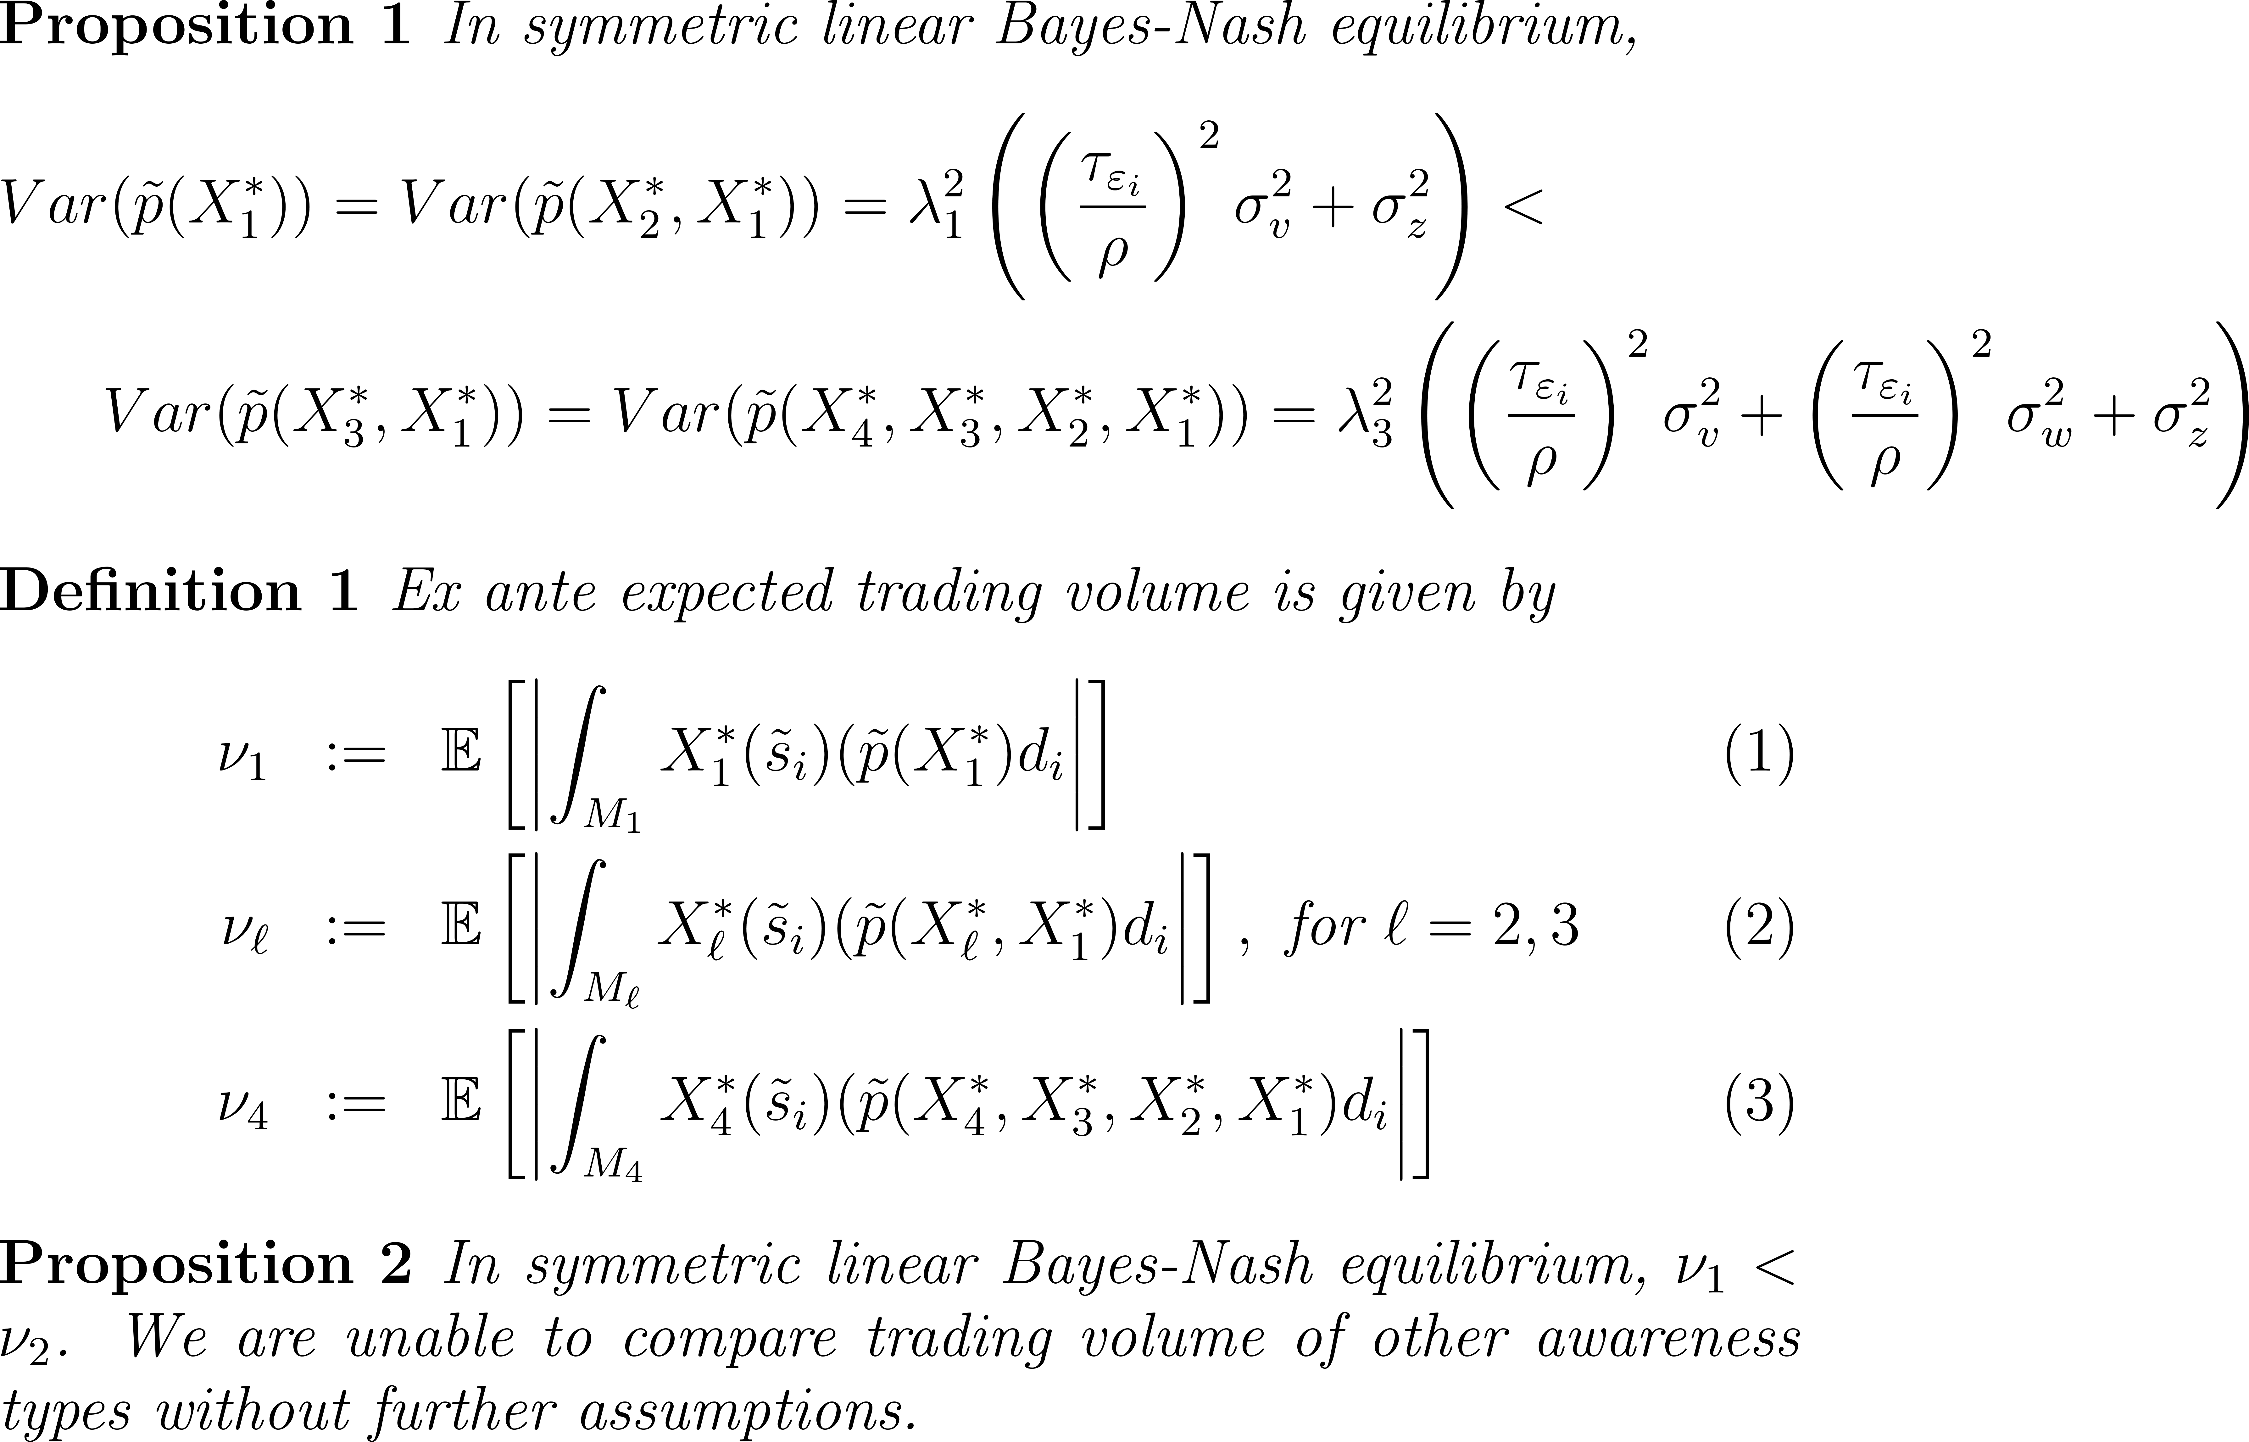

Slide 32


Slide 33


Slide 34


