Slide 1

Rationalizable Screening under Unawareness
Alejandro Francetich
University of Washington, Bothell
Burkhard C. Schipper
University of California, Davis

Slide 2
Principal-agent problem
Procurement: Principal wants to procure some amount of a good from an agent
Asymmetric information: Marginal cost of the agent are hidden information. Agent knows his marginal cost. Principal does not know.
Asymmetric awareness: Principal is also unaware of some events affecting the marginal cost of the agent
Communication may arise as some types of the agents may want to raise the principal’s awareness in order to affect the menu of contracts offered by the principal for screening of types she is/become aware of.

Slide 3
Screening with finite types: Spence (1980), Cooper (1984), Maskin & Riley (1984), Matthews & Moore (1987)
Mechanism design with prior verifiable information: Pram (2021), Ali, Lewis & Vasserman (2020)
“Reverse Bayesianism”: Karni & Viero (2013), Dominiak & Tserenjigmid (2018)
Contract theory with unawareness:
Moral hazard: von Thadden & Zhao (2012), Auster (2013),
Insurance: Filiz-Ozbay (2012),
Optimal delegation: Auster & Pavoni (2021), Lei & Zhao (2021)
Others: Grant, Kline & Quiggin (2012), Ma and Schipper (2012)

Slide 4
Disclosure under unawareness: Heifetz, Meier & Schipper (2020), Li & Schipper (2021), Schipper & Woo (2019)
Implementation in rationalizability strategies with belief restrictions: Penta & Ollar (2017)
∆-rationalizability and iterated admissibility: Pearce (1984), Battigalli (1997, 2006), Battigalli &Friedenberg (2012), Battigalli & Prestipino (2013), Battigalli & Siniscalchi (2002, 2003), Brandenburger, Friedenberg & Keisler (2008), Brandenburger & Friedenberg (2010)
Games with unawareness: Heifetz, Meier & Schipper (2013a, b, 2020), Meier & Schipper (2014, 2012), Schipper (2018), Halpern & Rego (2012, 2014), Feinberg (2020)

Slide 5
Model

Slide 6
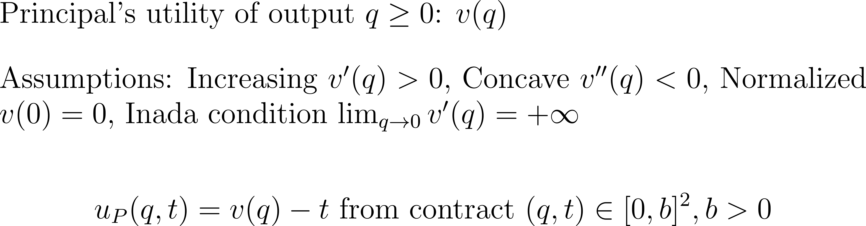
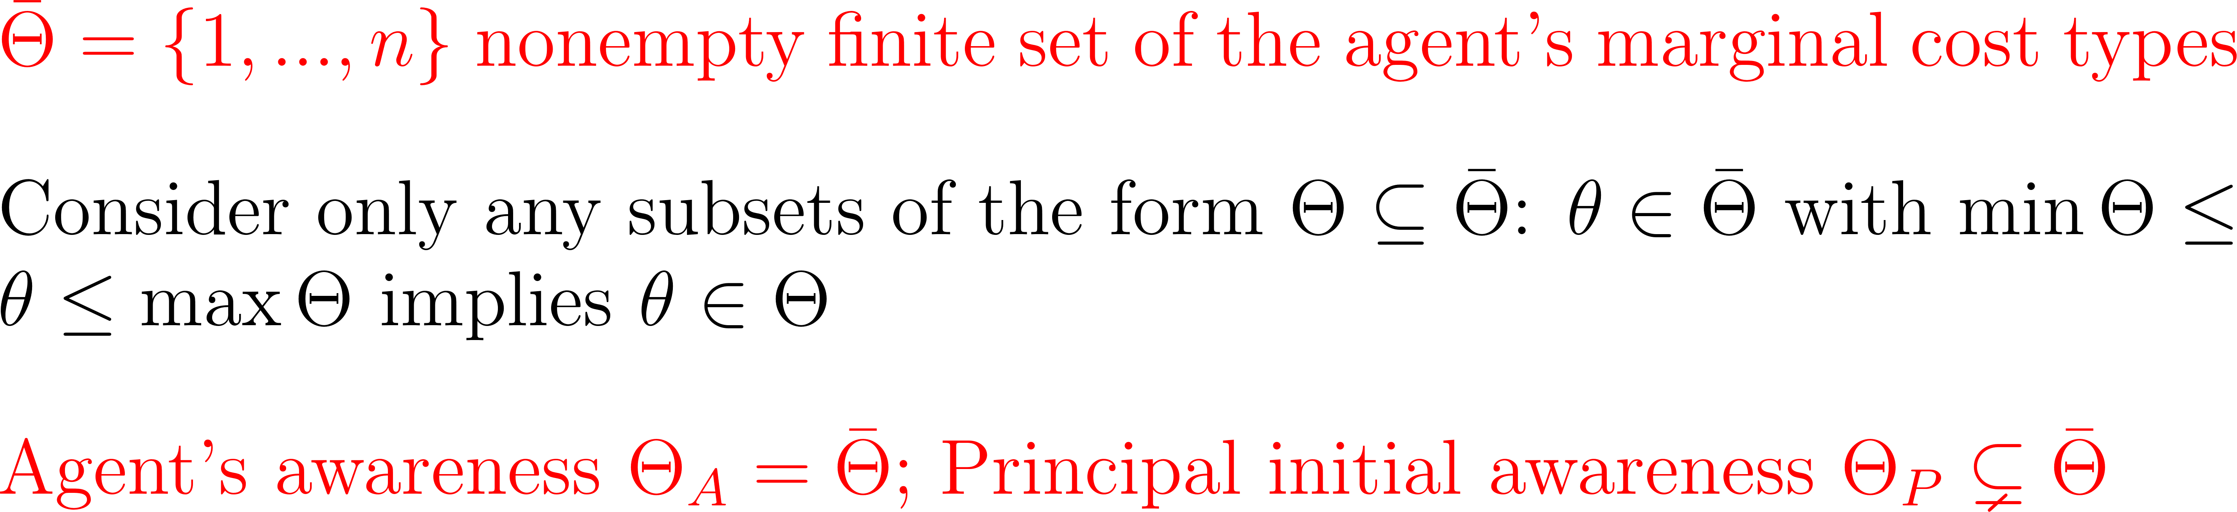
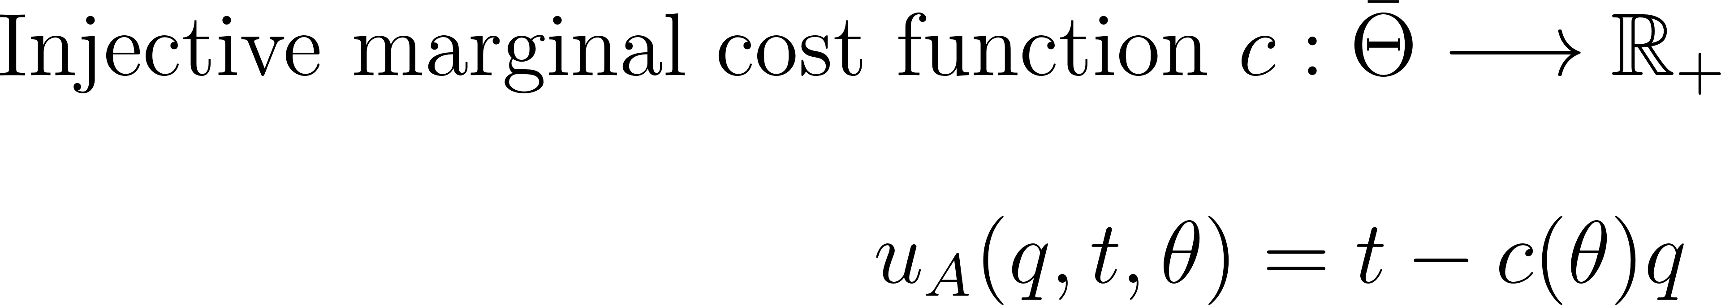

Slide 7
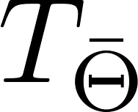




c
A
A
A
A
P
P
P
P
Disclosure choice
A
A
A
A
P
P
P
P
A
A
A
A
Menu of contracts
P
A
A
A
A
Contract choice

Slide 8
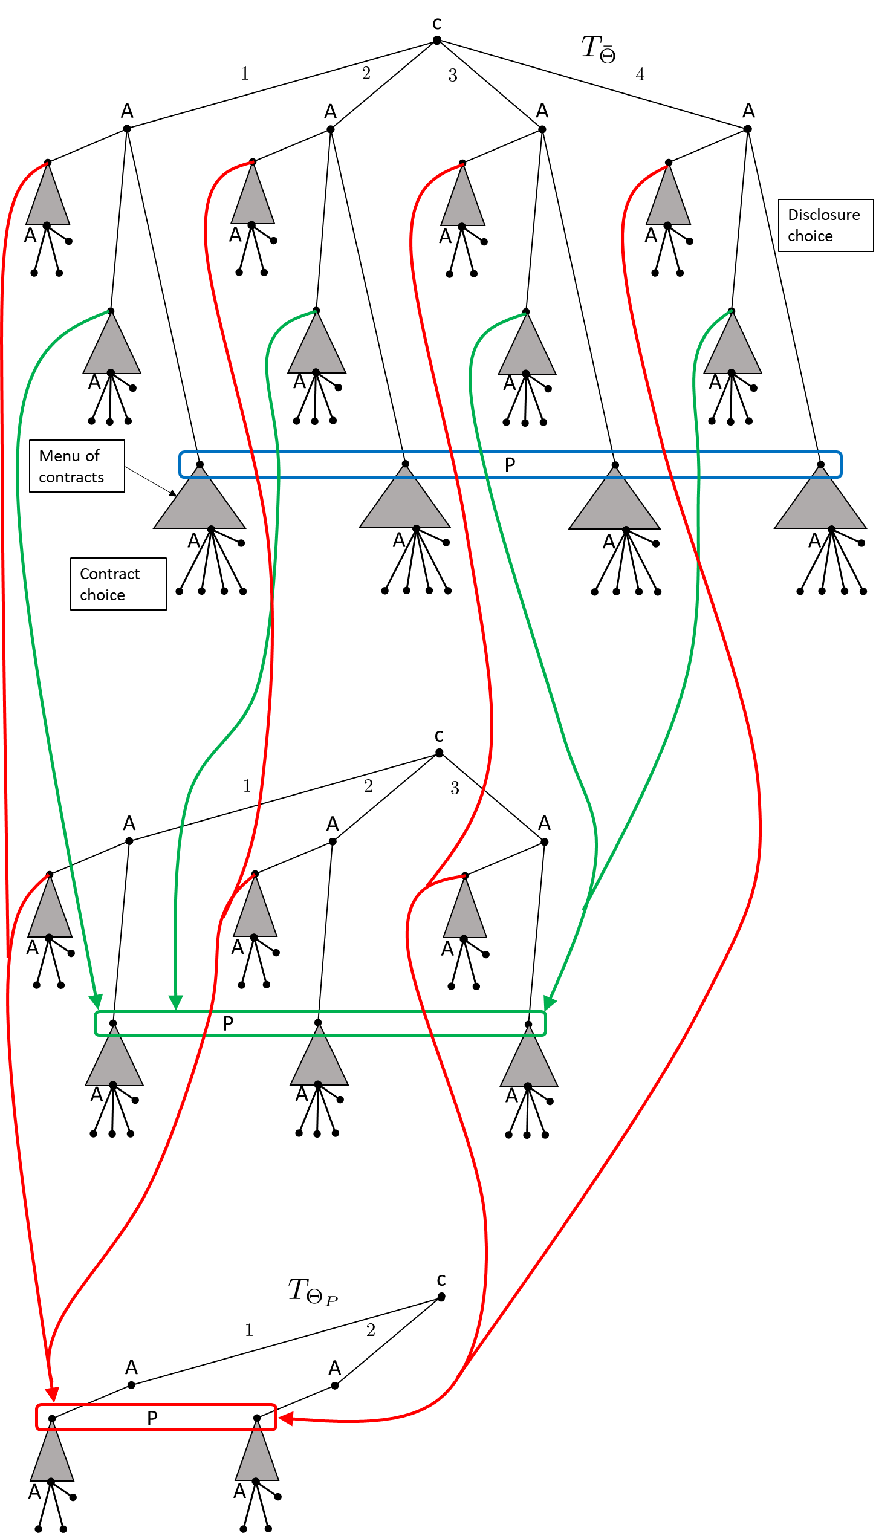
Extensive-form game with unawareness à la Heifetz, Meier and Schipper (2013):
Forest of game trees (partially) ordered by “expressiveness” (set inclusion of actions)
Information set at a history in one tree may comprise of histories in a less expressive tree
No delusion: A player may miss an action but cannot “make them up”

Slide 9
Solution concept
Typically, equilibrium is a convolute of behavioral assumptions modeling a state of beliefs and play after something has equilibrated.
In games with unawareness, players can be surprised. It may model a situation that has not yet equilibrated.
Use a rationalizability concept: does not require us to make (implicit) assumptions about mutual beliefs of play (but just mutual beliefs of rationality)

Slide 10
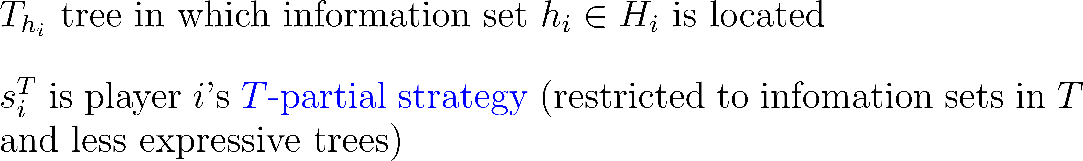

Slide 11
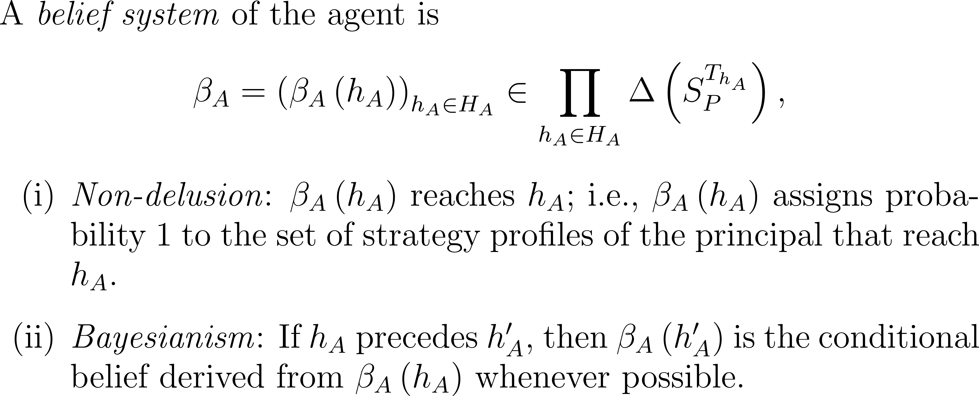
Agent forms beliefs at each of his information sets about strategies of the principal:
Nondelusion: Assigns probability 1 to the set of strategies reaching his information set
Bayesianism: Use conditional probabilities if possible

Slide 12
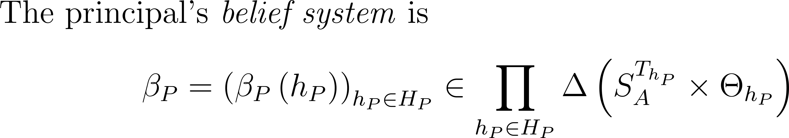
Principal forms beliefs at each of her information sets about strategies and marginal cost types of the agent that she is aware of at that information set
Nondelusion
“Reverse” Bayesianism of marginal beliefs over types: If any prior type cannot be ruled out upon becoming aware, the prior marginal on types is the conditional of the new marginal on types.
Logconcavity of marginal beliefs over types: Unimodal marginal beliefs on types

Slide 13
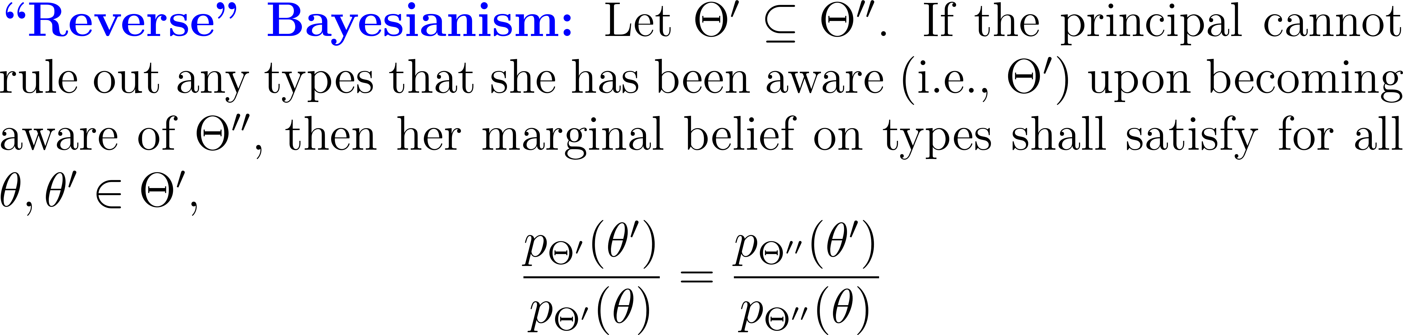
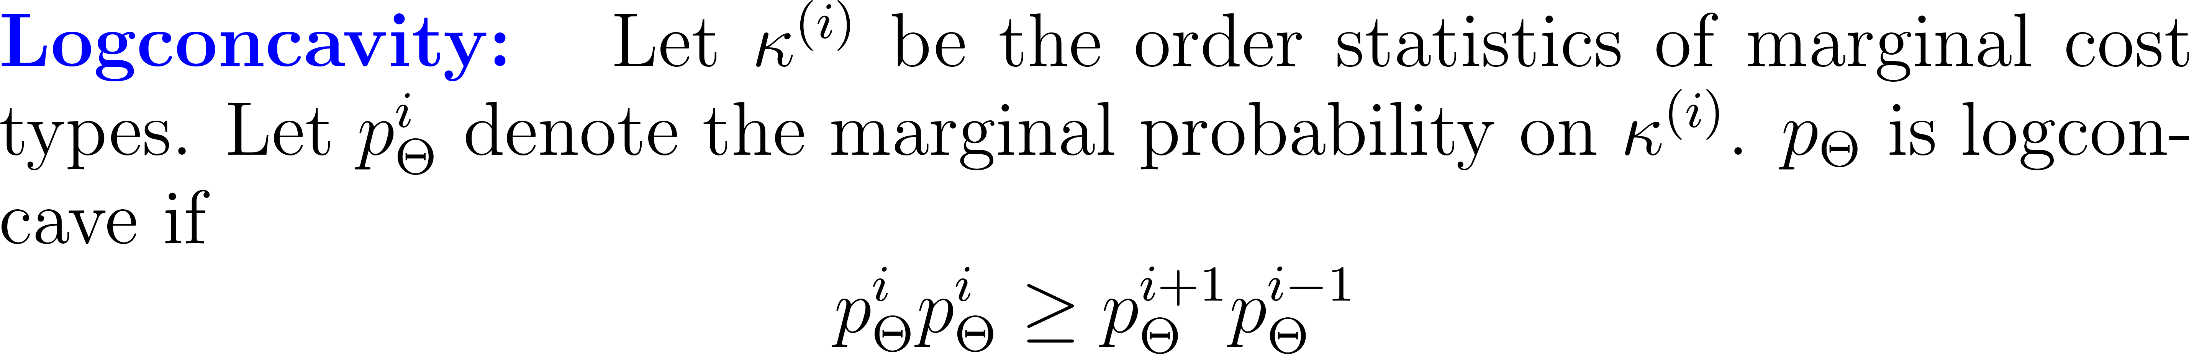
Axiomatized within single-person subjective expected utility by Karni and Viero (2013) and others
Less compelling in game theory but here applied only when no prior type can be ruled out.
Standard assumption in asymmetric information economics
Implies monotone hazard rates; rules out bunching; tractability

Slide 14
∆-Prudent Rationalizability: Define inductively
Level 0: All strategies
Level 1: The agent has non-delusional full support beliefs over principal’s level-0 strategies that satisfy Bayesianism and behaves sequentially rational. The principal has nondelusional full support beliefs over agent’s partial level-0 strategies with marginal on types satisfying logconcavity and reverse Bayesianism, and behaves rationally.
Level 2: The agent has non-delusional full support beliefs over principal’s level-1 strategies if possible that satisfy Bayesianism and chooses sequentially rational among level-1 strategies. The principal has nondelusional full support beliefs over agent’s partial level-1 strategies if possible with marginal on types satisfying logconcavity and reverse Bayesianism, and chooses rationally among level-1 strategies.
…
Set of ∆-Prudent Rationalizable Strategies: Infinite intersection over all level k rationalizable strategies.

Slide 15
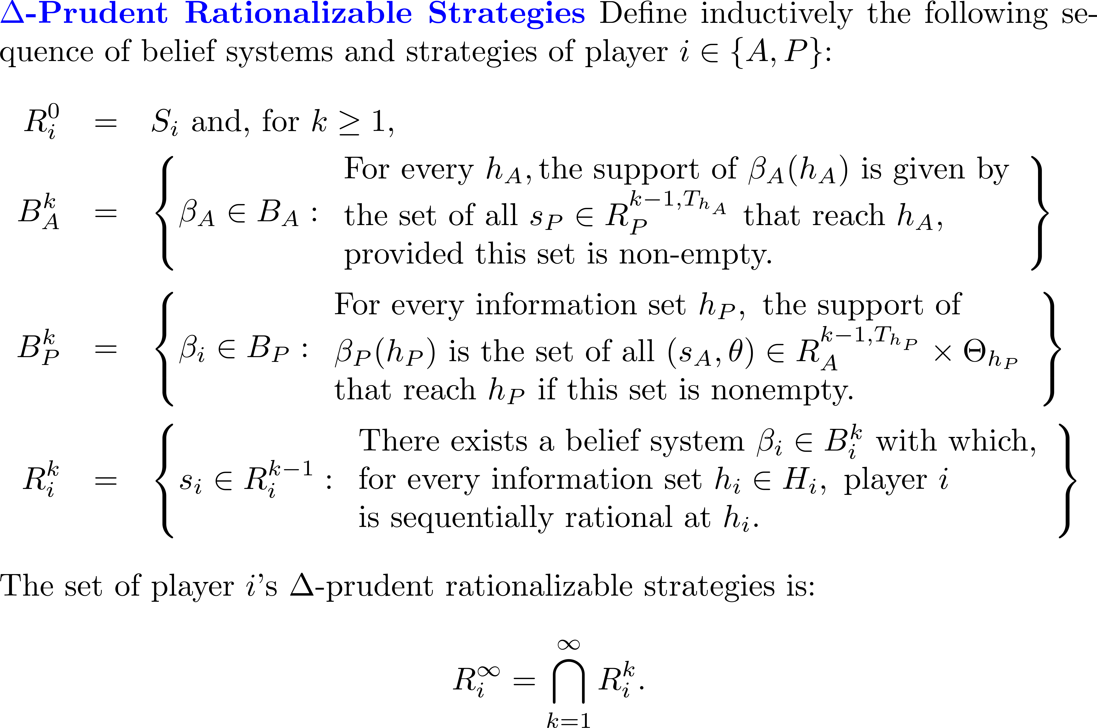

Slide 16
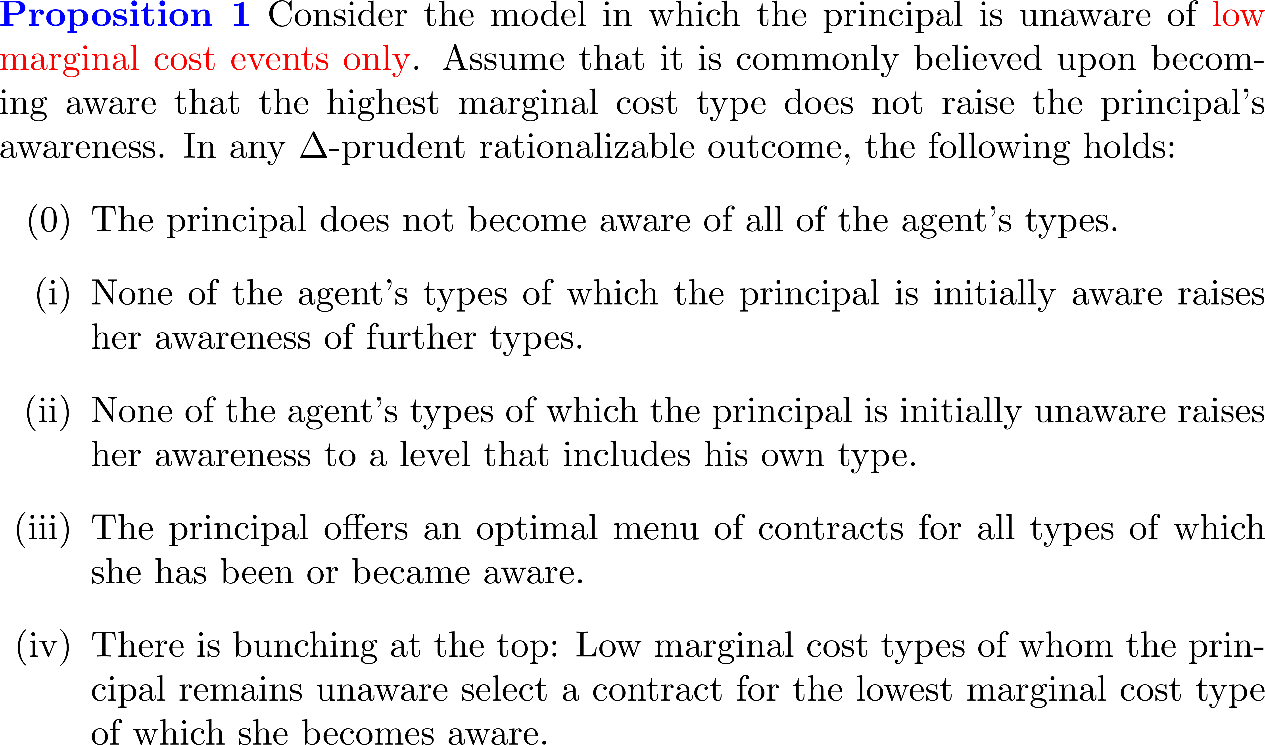
We prove inductively two results:

Slide 17
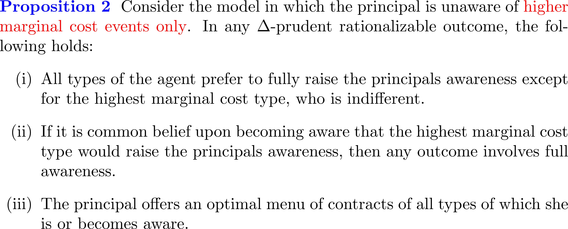

Slide 18
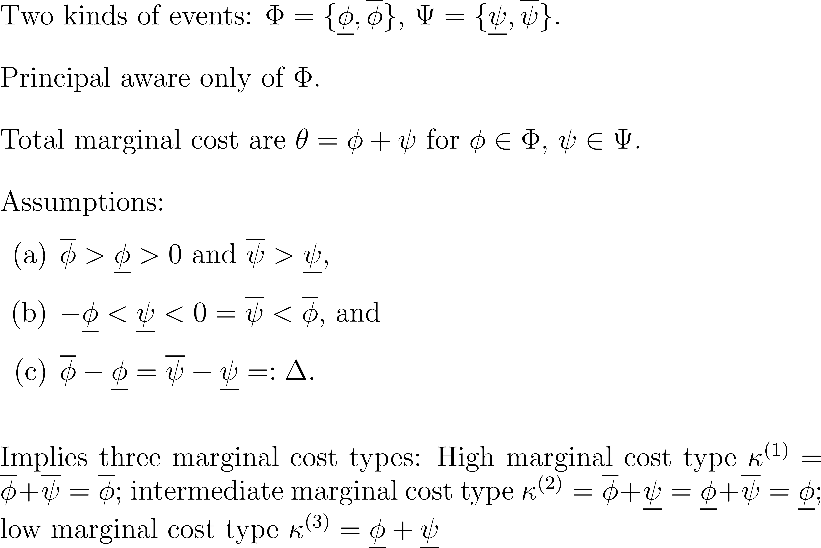
Proof of Proposition 1 simplified to three types:

Slide 19
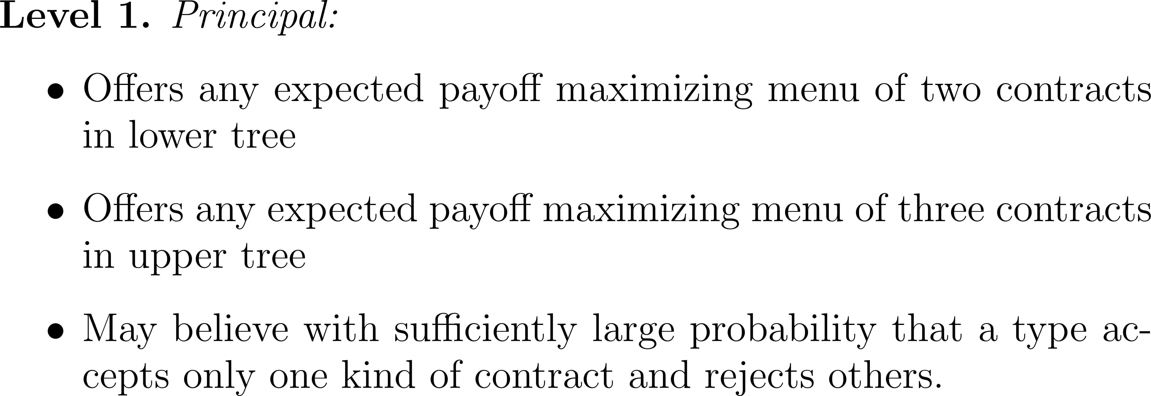

Slide 20
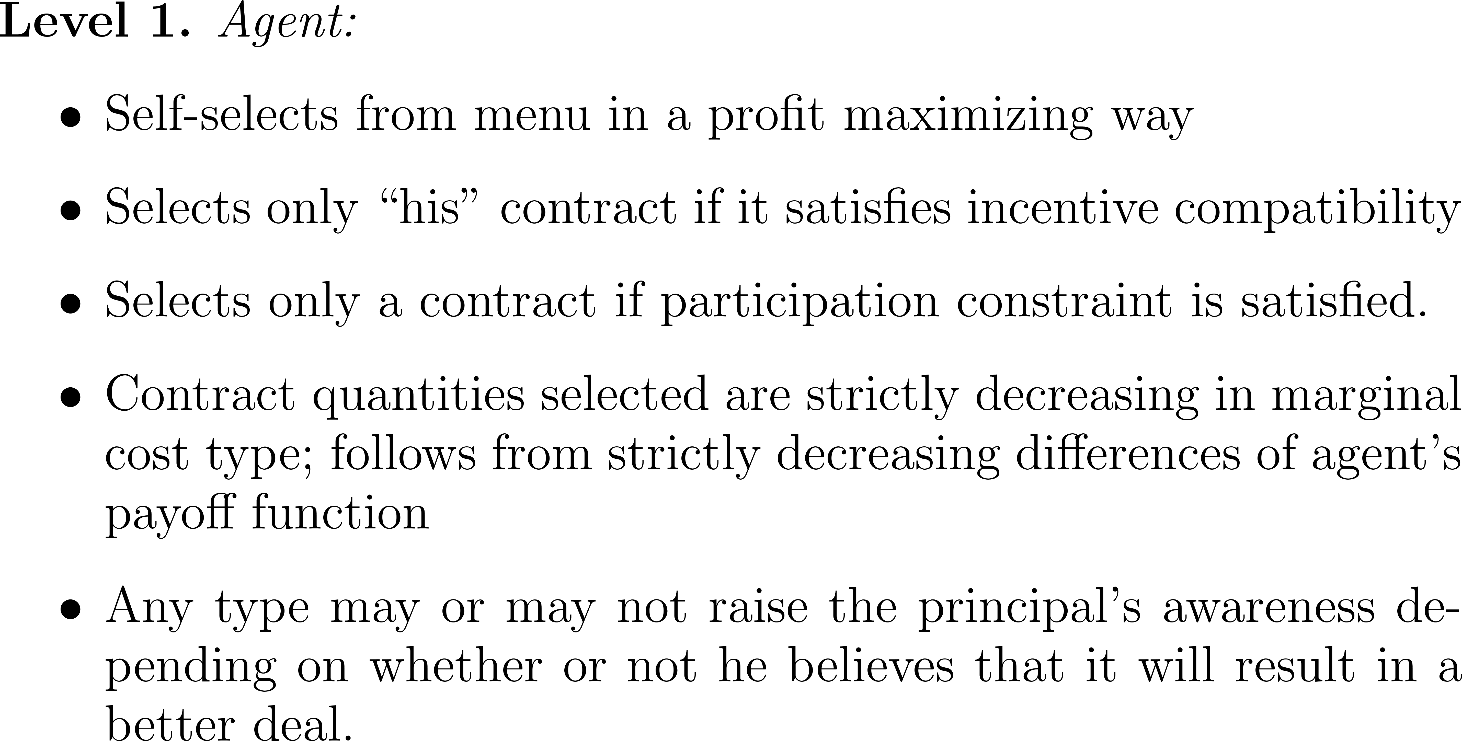

Slide 21
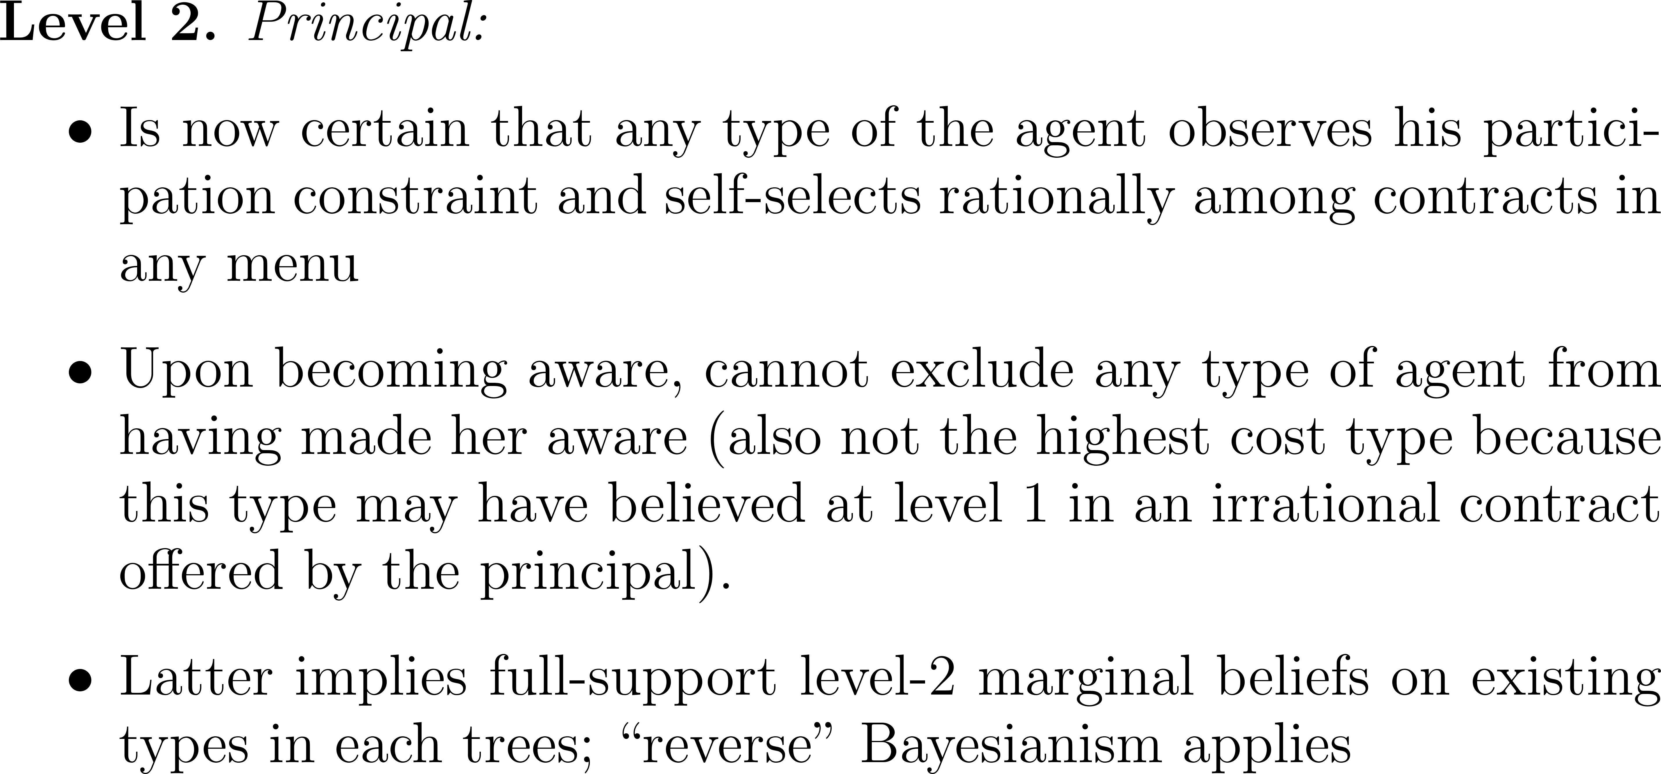

Slide 22
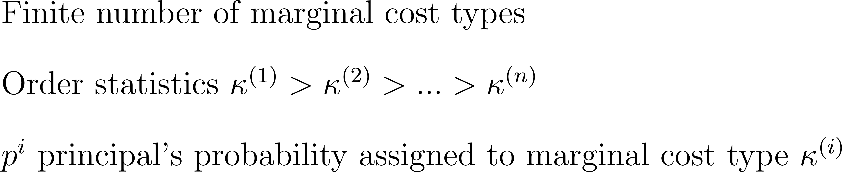
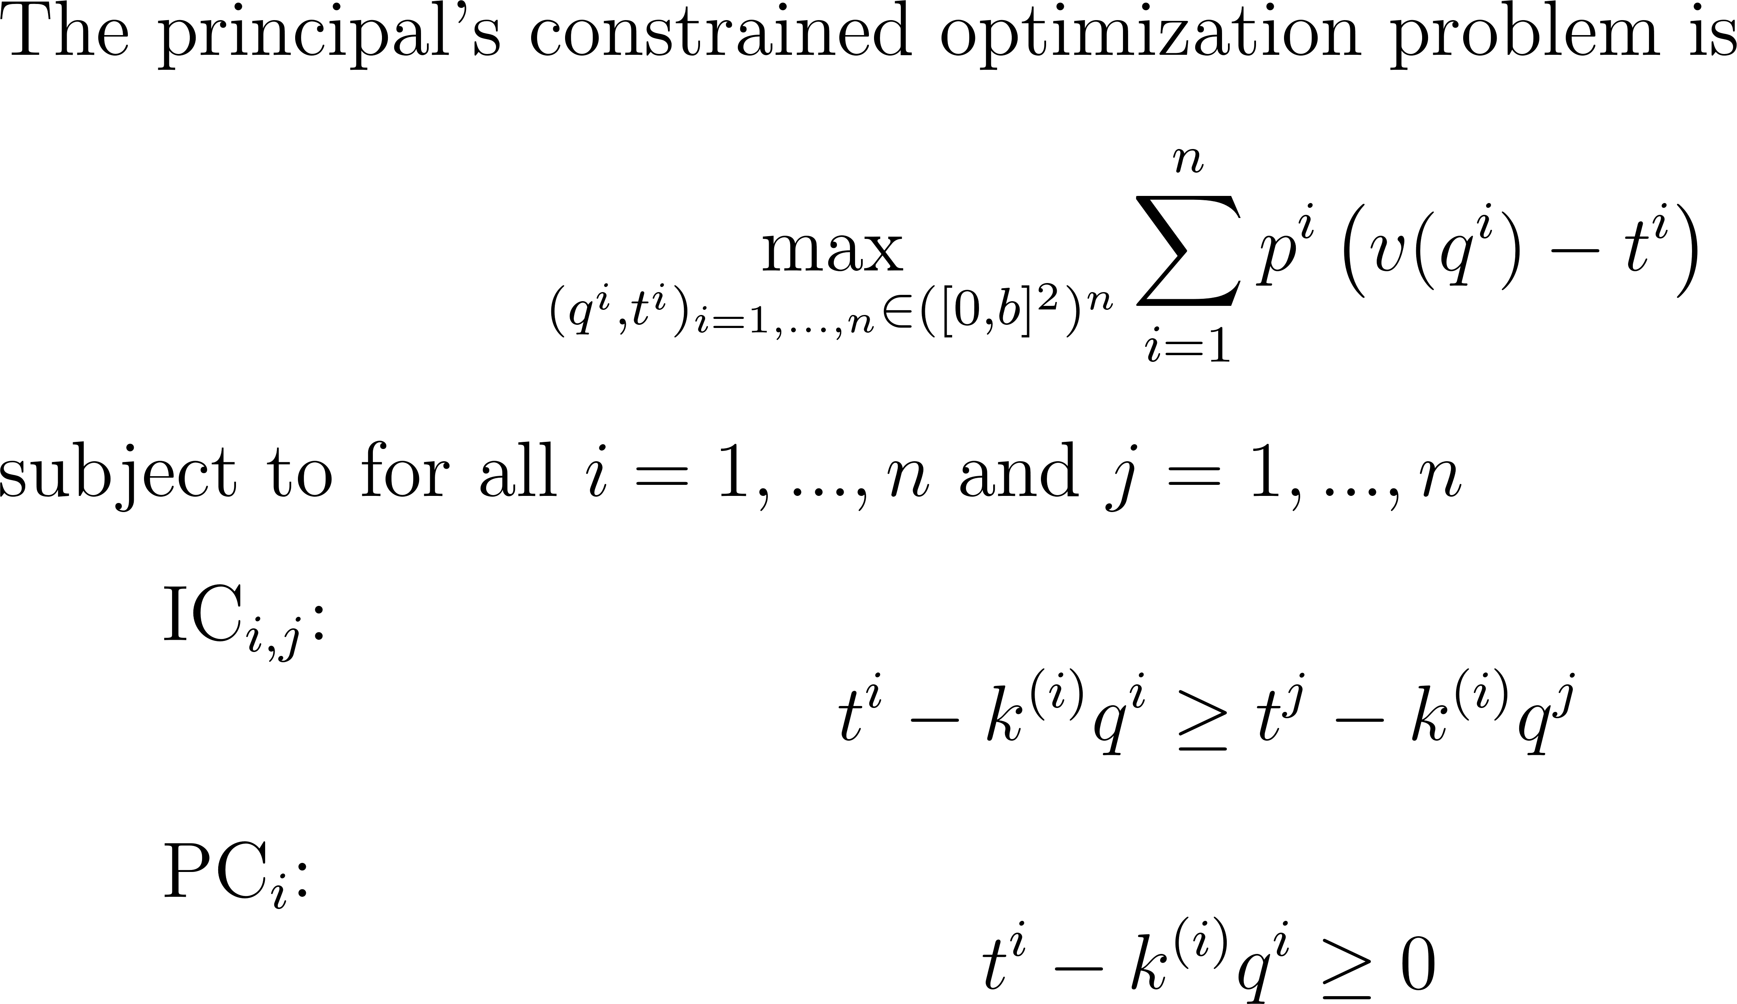

Slide 23
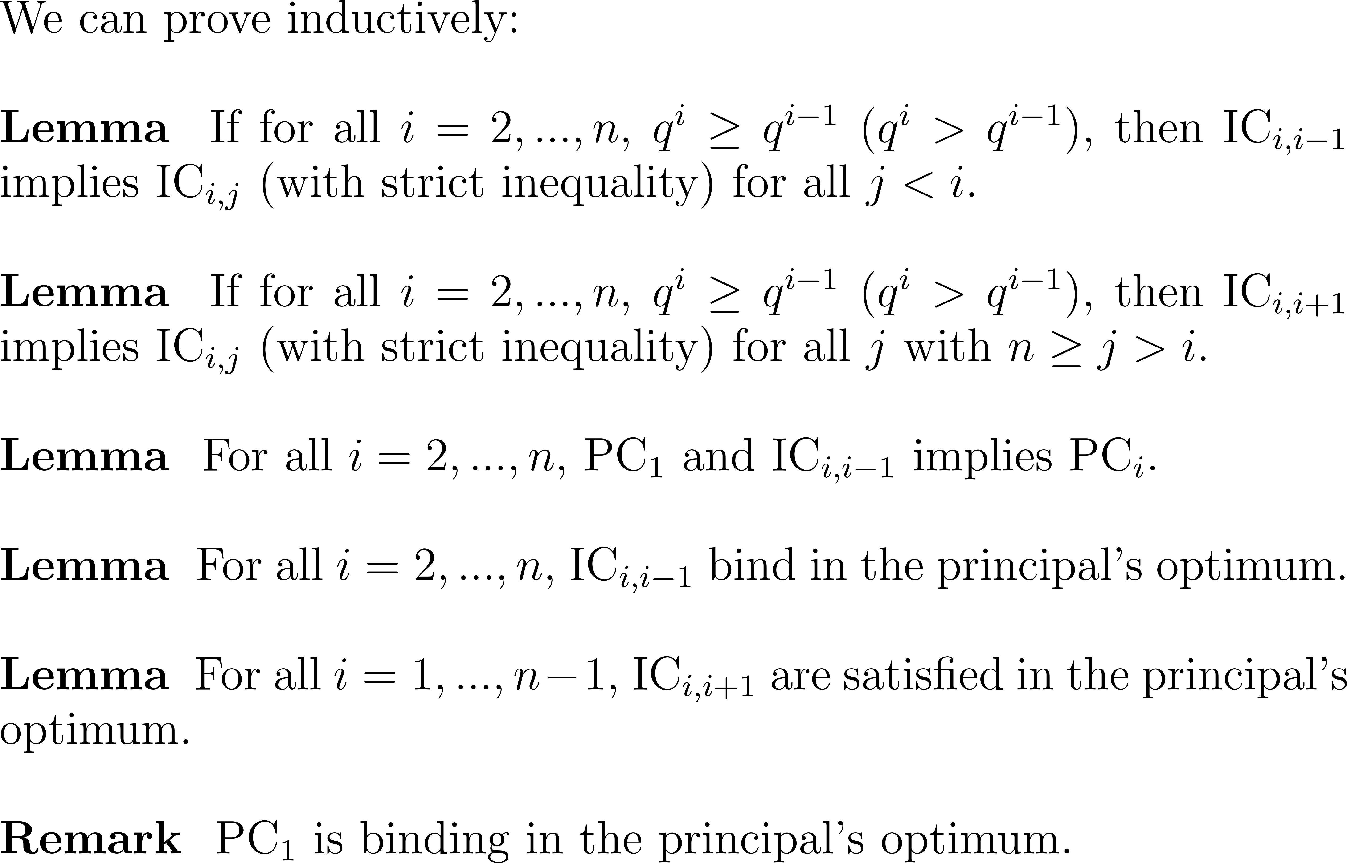

Slide 24
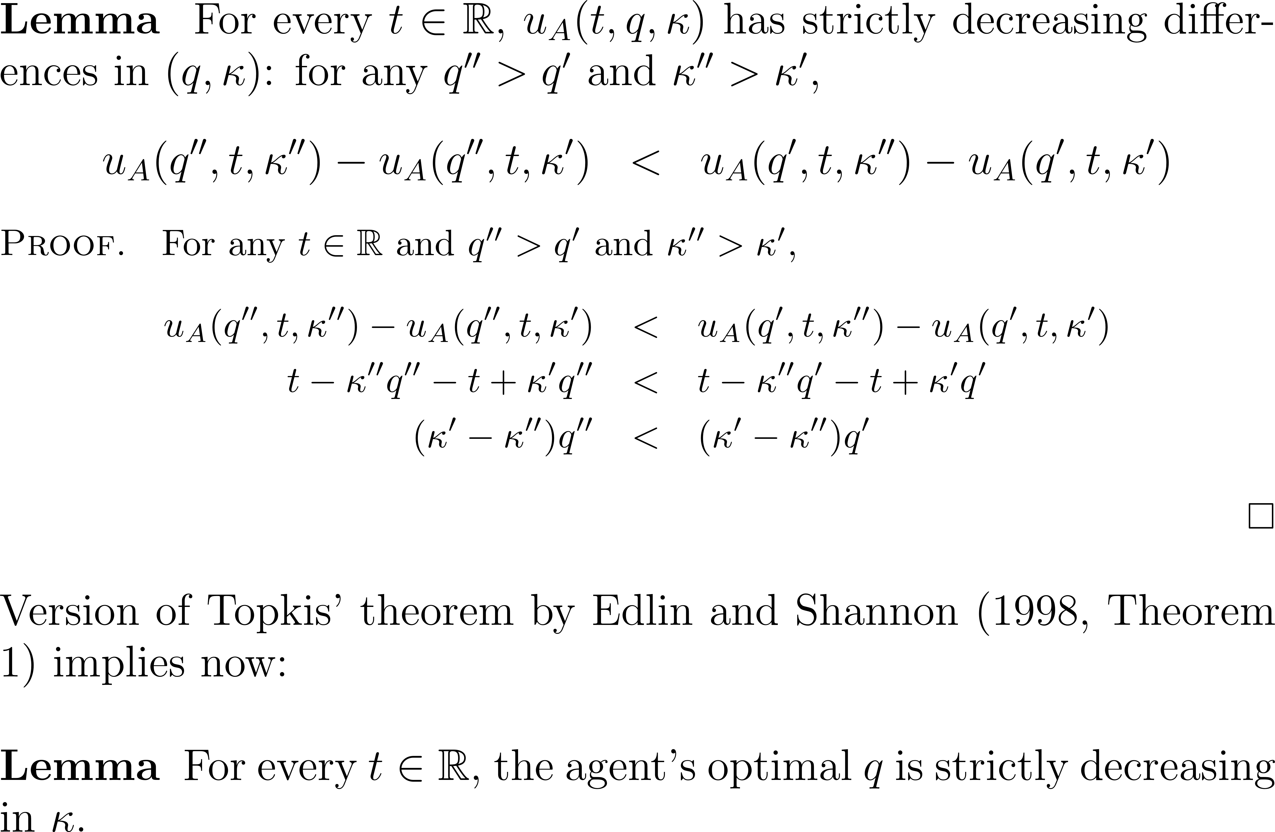

Slide 25
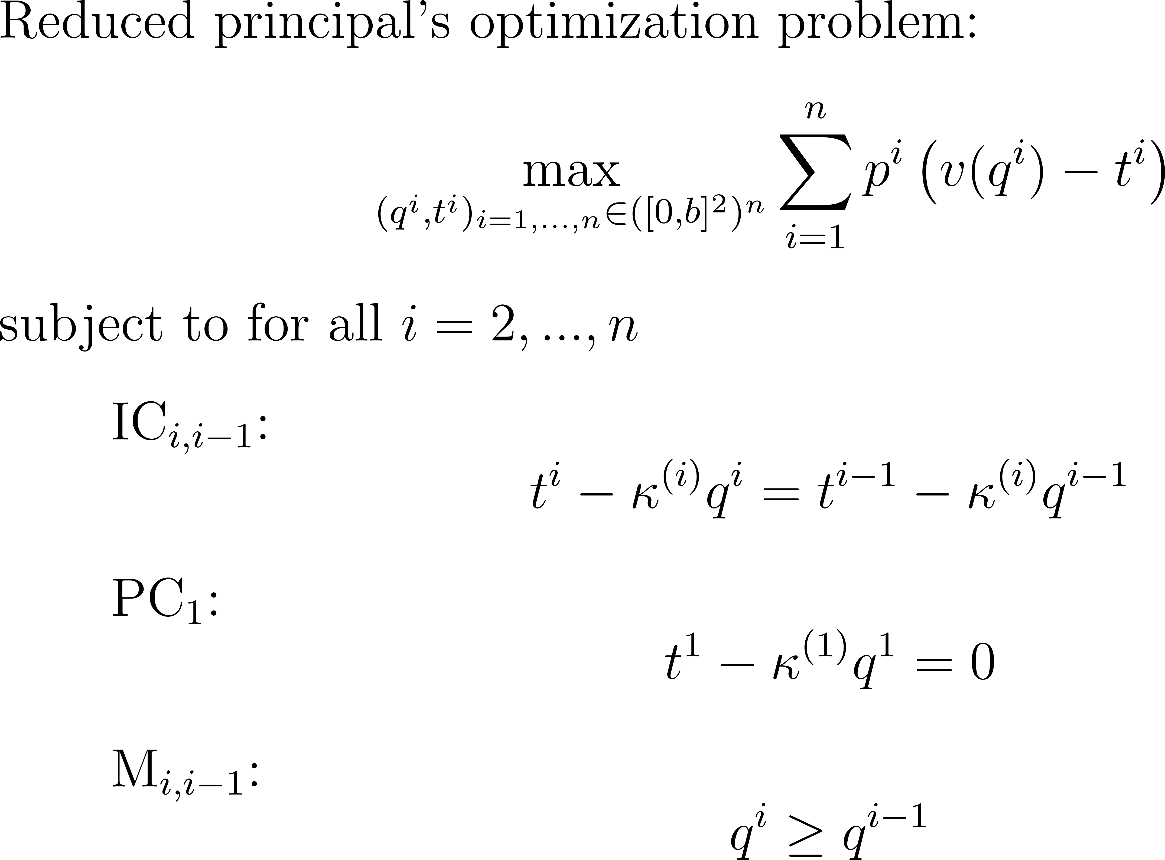

Slide 26
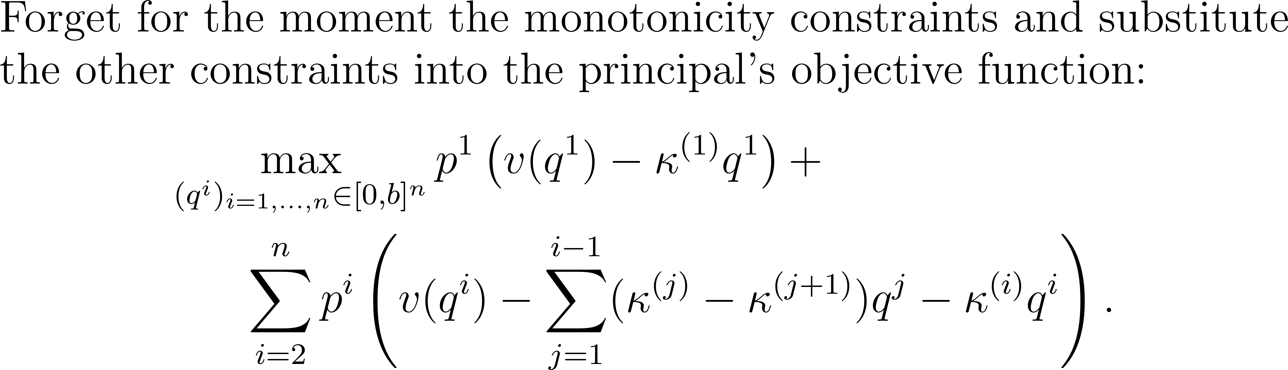
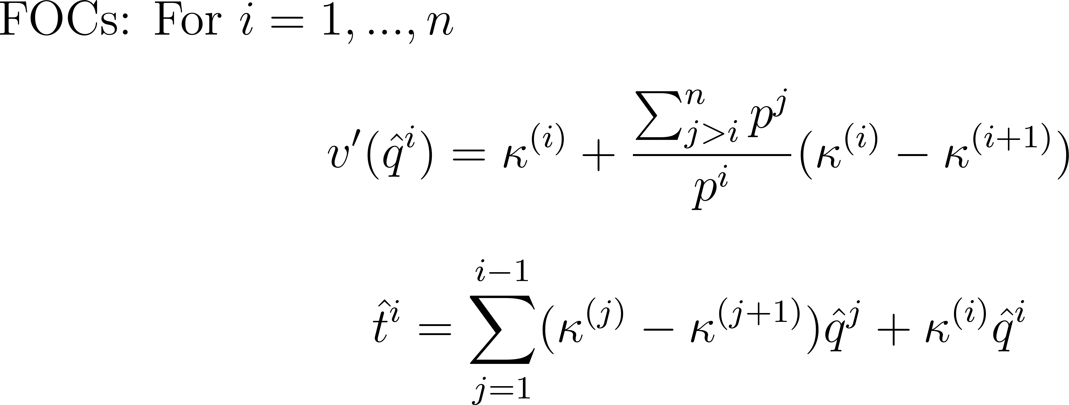

Slide 27
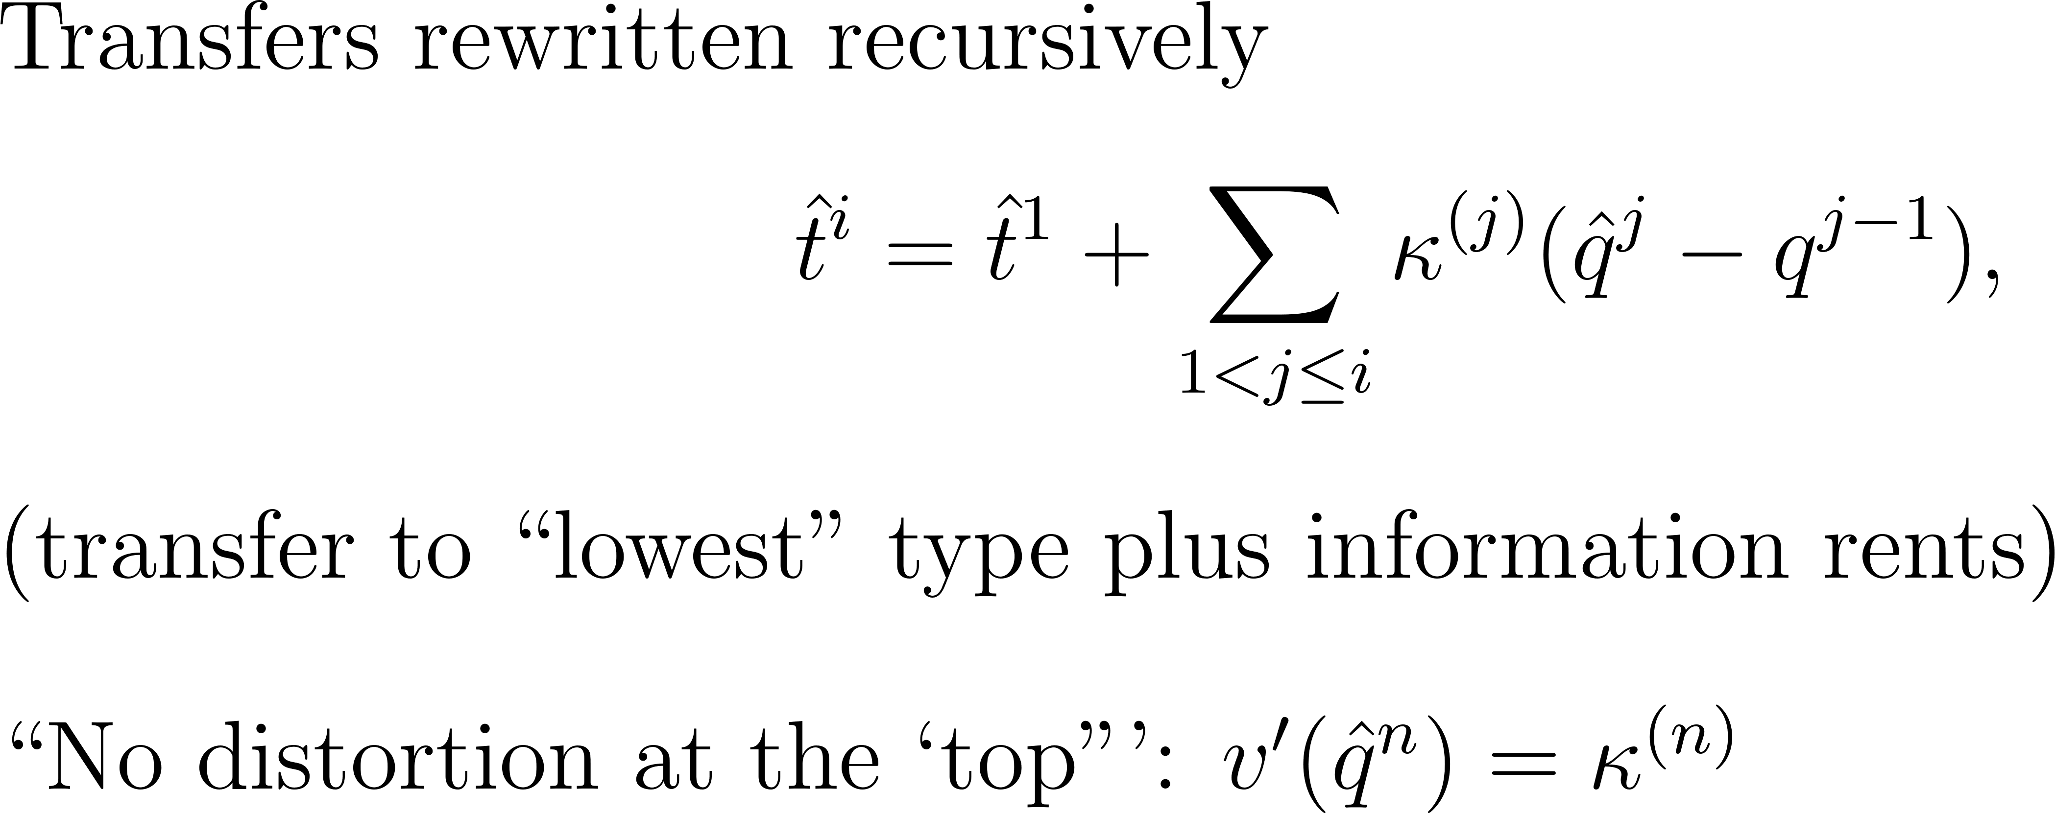

Slide 28
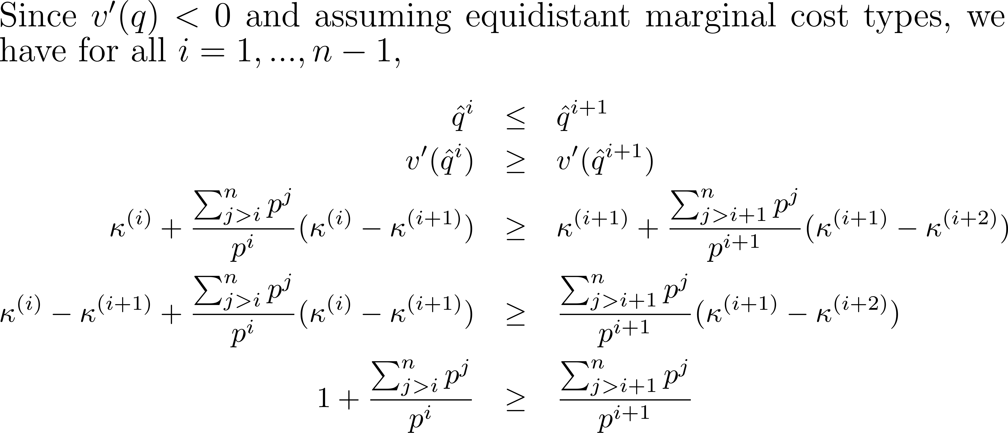
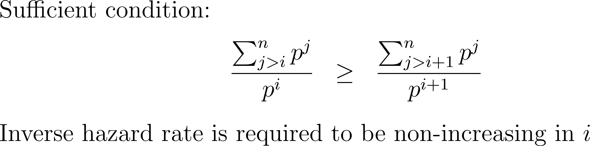

Slide 29
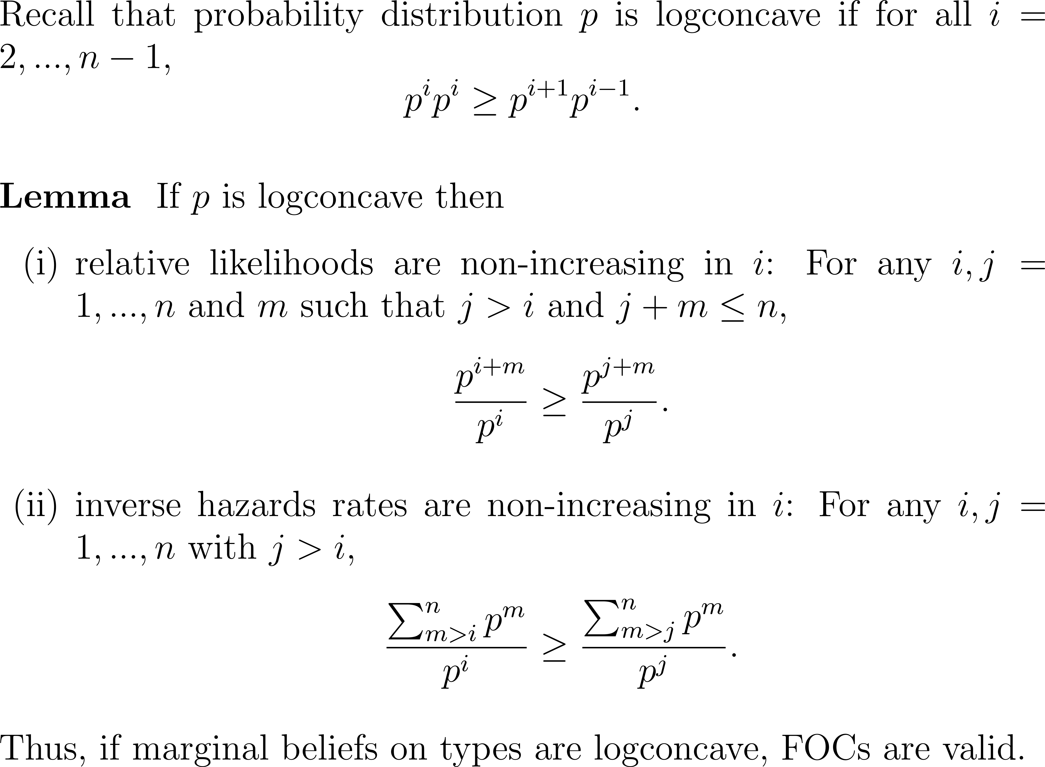

Slide 30
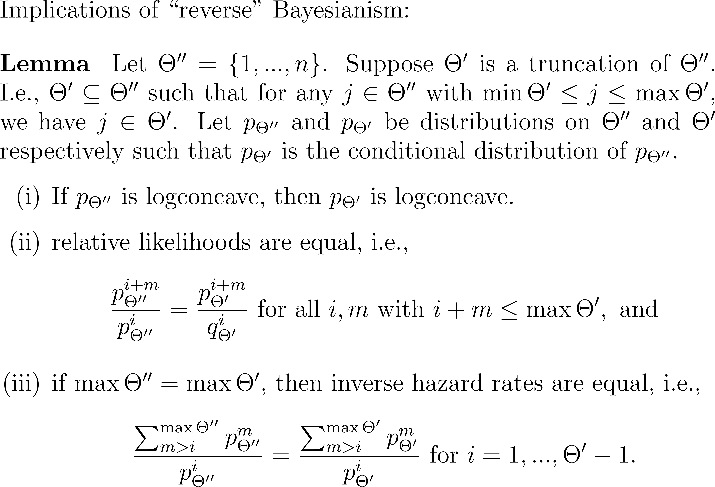

Slide 31
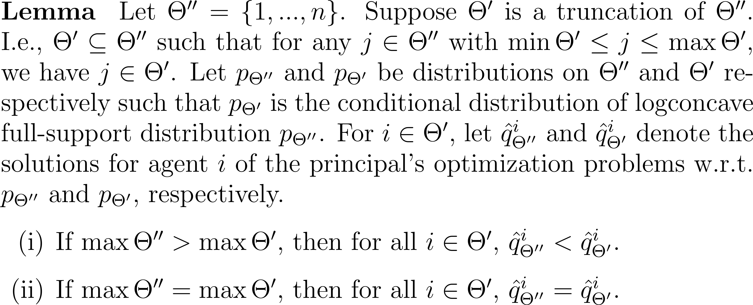

Slide 32
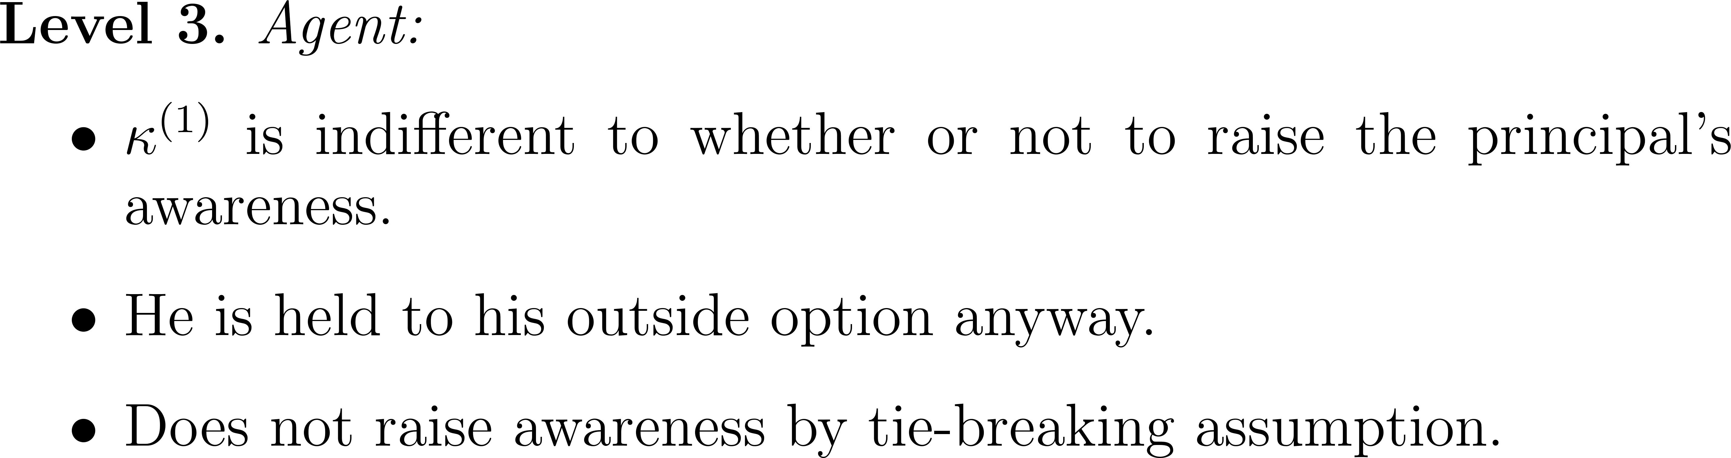
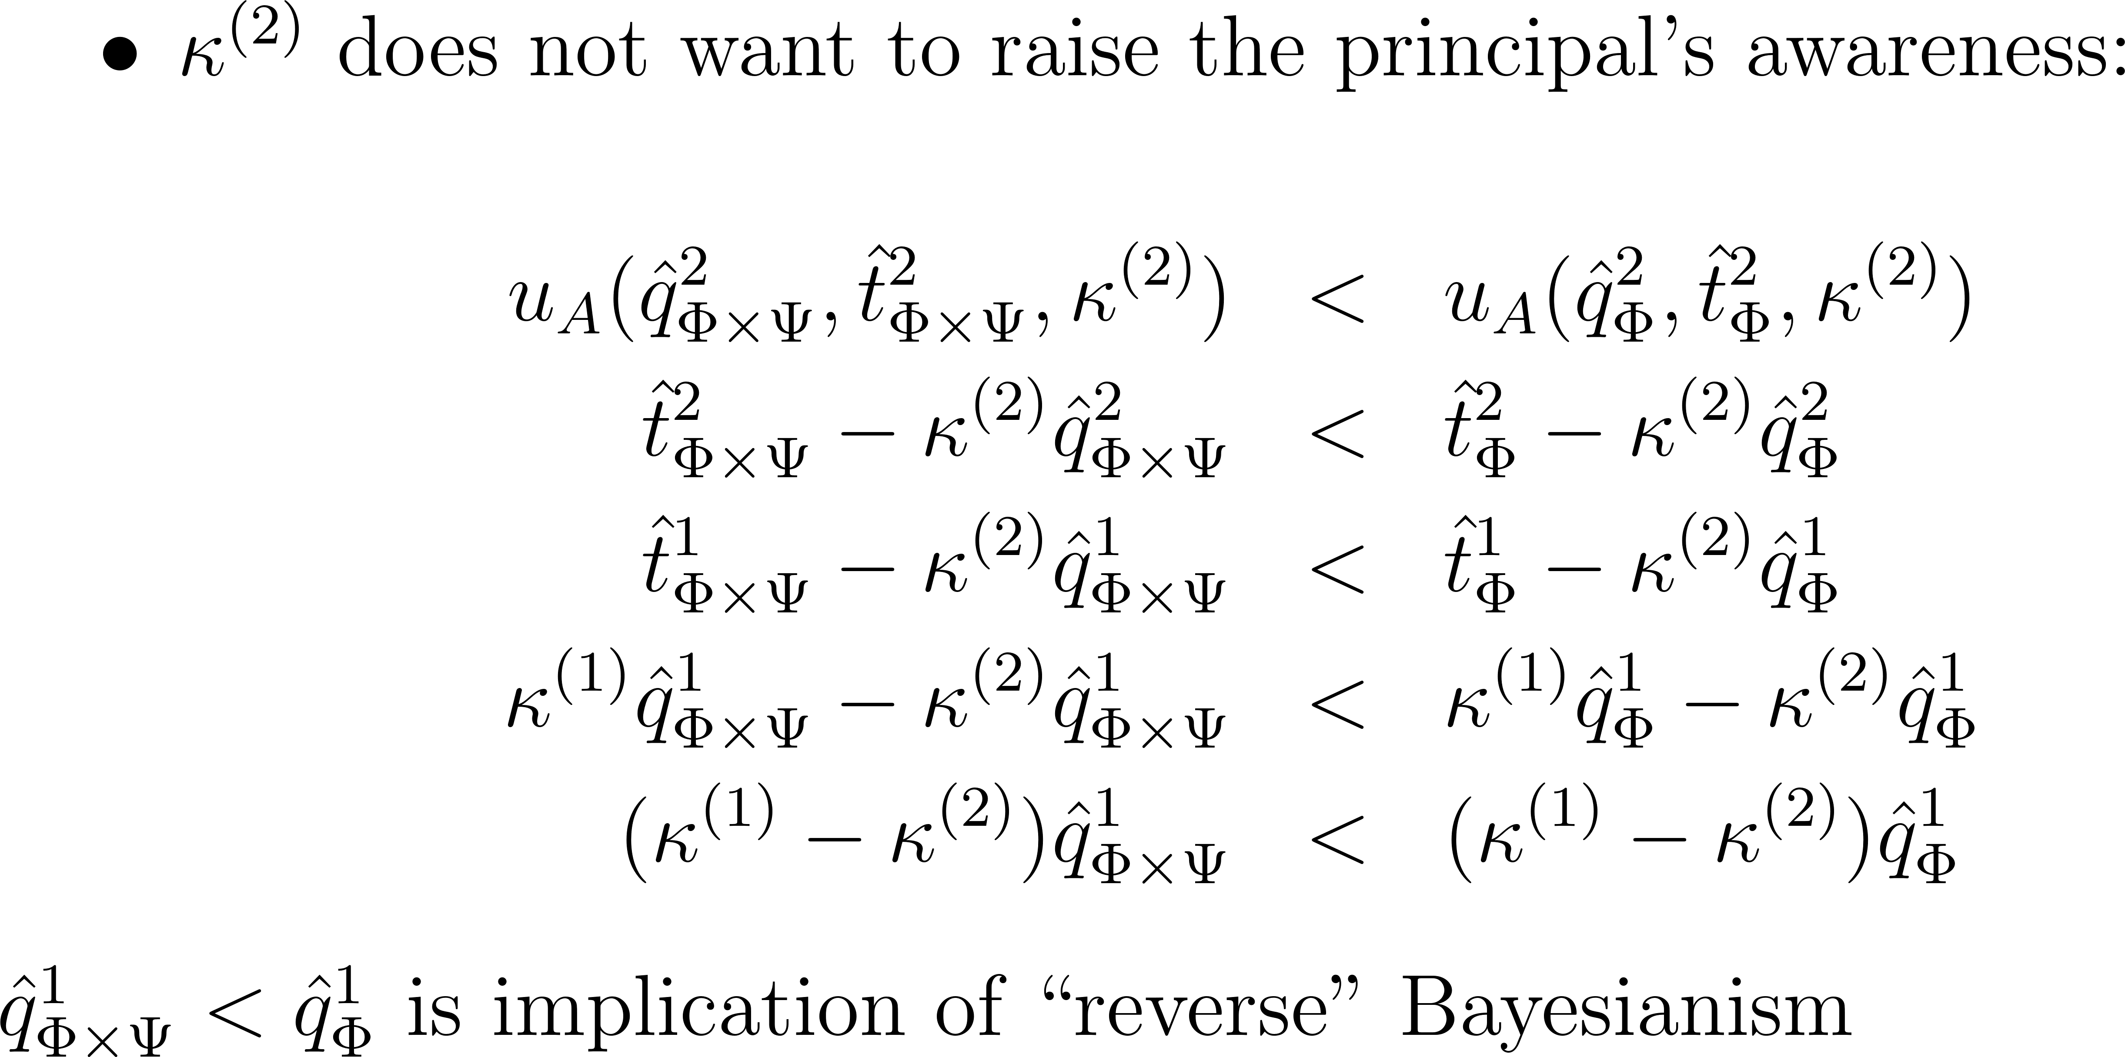

Slide 33
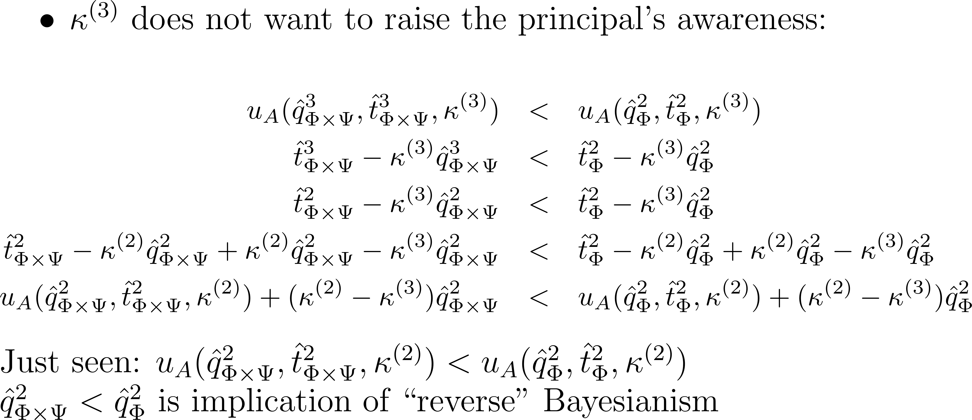

Slide 34
Corollary on Welfare
If the principal is unaware of high marginal cost events only, then in any ∆-prudent rationalizable outcome, ex post welfare is identical to the case of just incomplete information. This relies crucially on allowing disclosure of awareness. Disclosure Pareto improves.
If the prinicipal is unaware of low marginal cost events only, then in any ∆-prudent rationalizable outcome, ex post welfare is lower than in the case of just incomplete information. This is due to bunching and distortion at the top. Thus, unawareness adds additional “frictions”. Disclosure of awareness is weakly interim Pareto improving.

Slide 35
Discussion
n-type case in paper: lots of induction
Results are intuitive but we had to work hard for it:
Logconcavity: for tractability
“reverse” Bayesianism: can be weakened to updating that preserves likelihood dominance
Caution or full support beliefs: necessary
Common strong belief in rationality: a finite level of mutual strong belief in rationality suffices
Tie-breaking assumption: a bit odd but couldn’t do without it
Extensions (n agents, disclosure of information & awareness, product of continua type spaces, multi-dimensional screening etc.), applications

